Slide 1
Different types of animation
Gladys Nzita-Mak

Slide 2
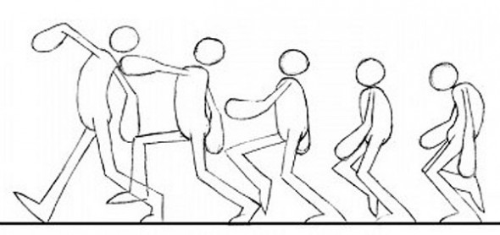
Movement
Movement is when an object changes its place or position, goes from A to B.
For example in the picture below, the person is moving from A to B. It starts off with a hunched back and keeps moving until it is straight and walking tall.

Slide 3
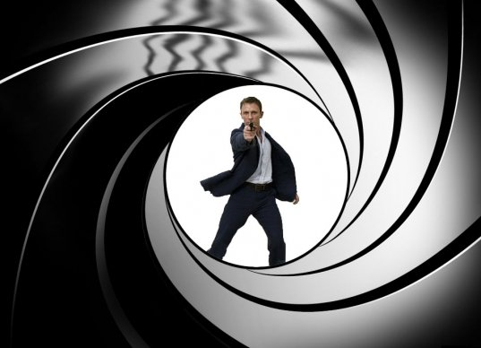
Masking
In animation, masking is used to cover an image so it can be moved to show the picture beneath.
Masking in the picture to the right is shown by the effect of a guns barrel over the camera lens aiming at James Bond, this makes him the focus, nothing else is needed to be seen but Bond. This is masking.

Slide 4
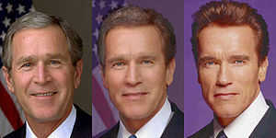
Morphing
Morphing is when an image changes into another image. This can be done frame by frame.
In the picture below, it shows George Bush morphing into Arnold Schwarzenegger.

Slide 5
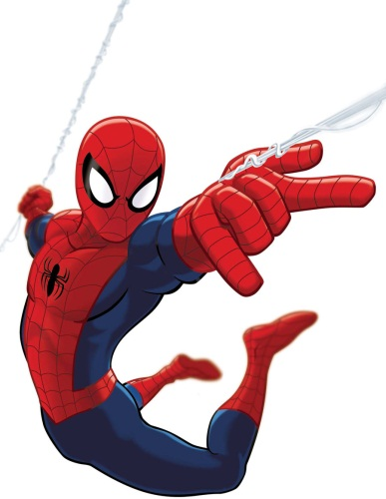
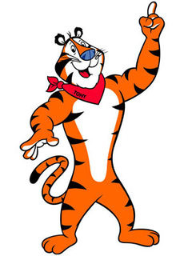
Different uses of animation

Slide 6
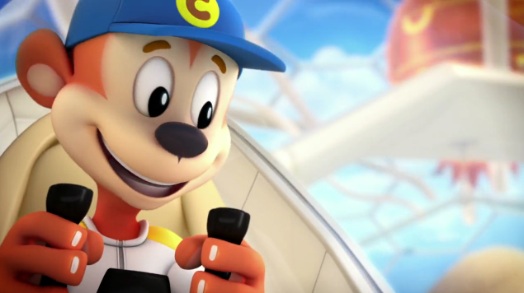
Advertising
When watching TV we come across adverts advertising different businesses and products. Companies tend to use animations more when advertising because it is more entertaining and keeps the viewers from changing channels.
Animations like the Cocoa Pops advert are highly popular, because once kids see the advert, it draws them in and makes the child want to ask their parent to actually buy the cereal.

Slide 7
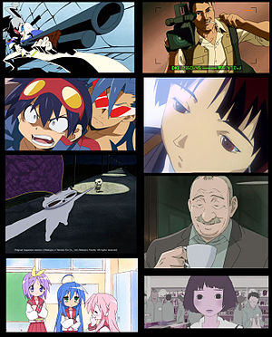
Entertainment
Animation has been used in entertainment for films, video games and TV shows. Animation is used in entertainment to make movies or TV shows more interesting.
Animation used in entertainment is used in TV shows such as Anime.
Animators use computer animation to improve the productivity of the production process.
When making anime, they go through the processes of storyboarding, character design, voice acting and cel production.

Slide 8
Education
Animation in Education can be used to keep a student interested in what they're learning. They can be used to demonstrate different learning examples. For example in the picture you can see an animation explaining the features of a cliff

Slide 9
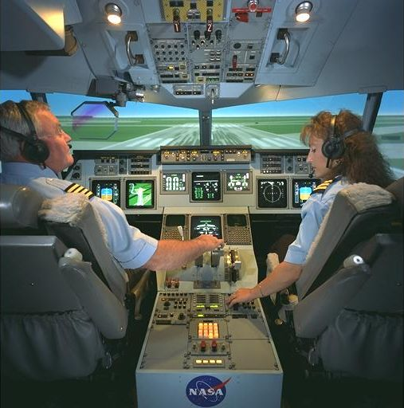
Simulation
Animation used for simulation is showing the real world through a computer program. For example when a pilot is in training, they use a flight simulator, and it feels and looks like they’re actually flying and controlling a plane. Simulators can be 3D and based on the real world, but is not dangerous.

