Slide 1
Background will be black
Title
Image
On this frame will be the WWE logo. It will appear for two seconds. Music representing the company will start playing here. (Vince McMahon – No chance in hell)
A title will appear here and the company’s logo will remain here in the corner in all frames
Here an image will display of the two brands in the WWE which are called “Smackdown and Raw”
Background will be black
Background will be black
Here will be an image of the superstars and the divas (this will be on separate frames)
TV Listings
Text
On this frame I will be showing users the times that the TV programs come on (TV listings will show here).
Information will be displayed here about the company telling users what the company is and what goes on in the televised shows
Here on this frame will start to introduce some of the wrestlers that in the WWE showing users who they are expected to see if they were to watch the show
Notes:
When advertising a PPV, use Wrestlemania.

Slide 2
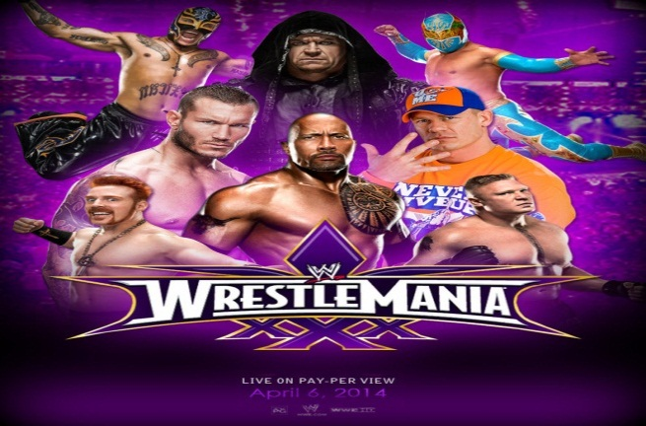
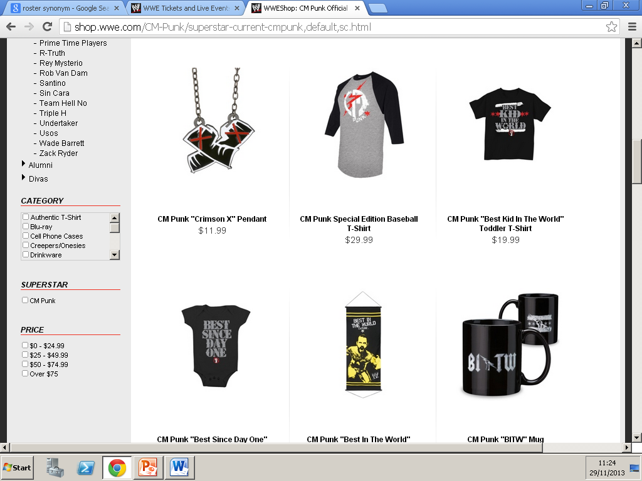
Background will be black
From this slide on images of famous wrestlers will be displayed
Text / information
In formation about the company will be displayed here talking about how the company has progressed over the years
On this slide I will be explaining what type of events go on in the WWE, for example TV events like a Pay-Per-View
I will be listing famous wrestlers that have come and gone in the WWE throughout recent years (this is done just to remind users how great the WWE is)
Tour dates and ticket information will be displayed here
From this slide images of the company’s merchandise will be shown and I will be listing what type of merchandise is available and how to buy them online
From this slide on I will be advertising tour dates for when the shows come to the UK and tickets that will be available to be bought by customers
Here I will be advising the end-user to sign up on the WWE website and listing benefits why signing up would be a good benefit for the end-users

