Slide 1
Software Components
Gladys Nzita-Mak

Slide 2
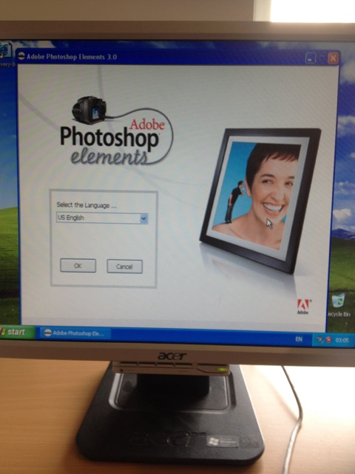
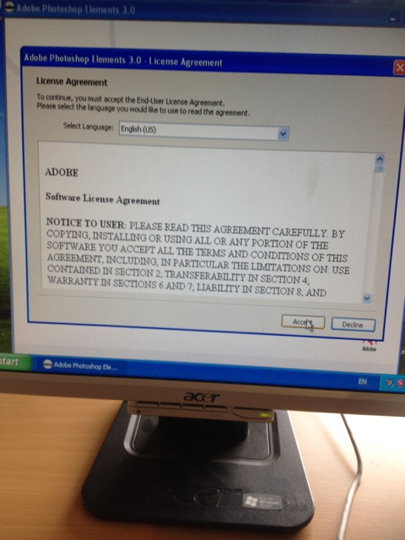
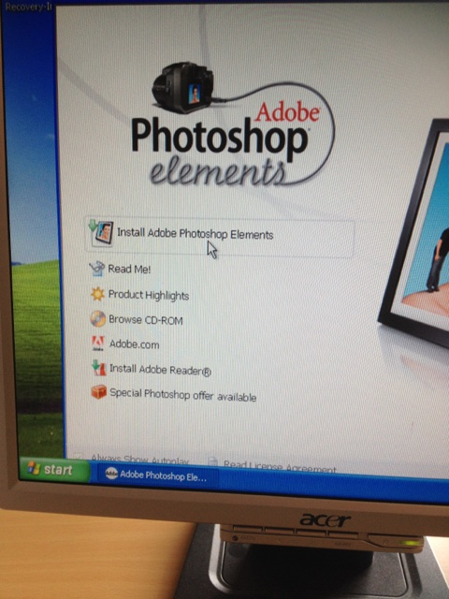
Adobe Photoshop elements
When you have inserted the CD into the computer, you will have to install Adobe Photoshop elements onto your computer. Firstly you are to select which language you would prefer then click “OK”, then you would have to accept the terms of agreement in order to move onto the installation.

Slide 3
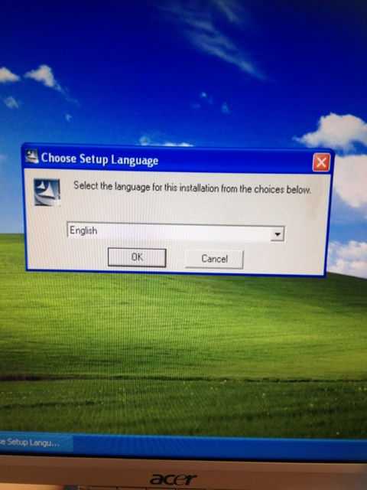
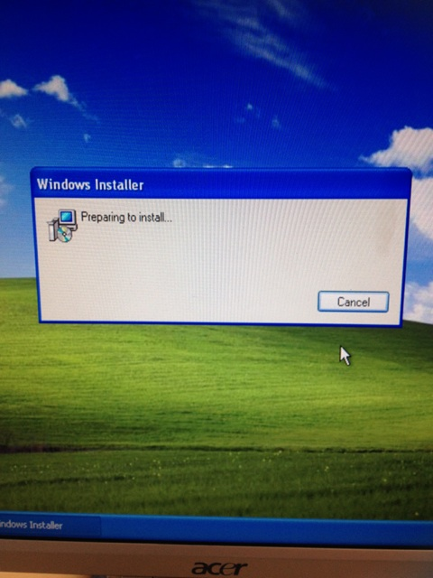
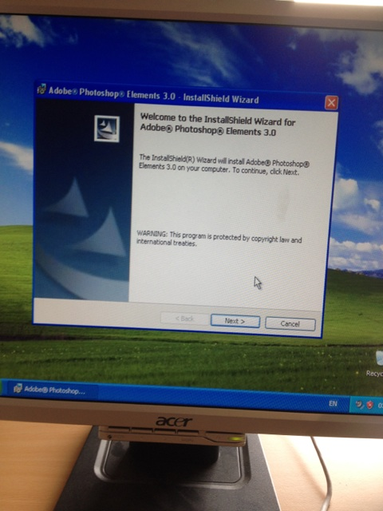
After clicking to install this software, you are to (again) select which language you want to choose (in this case English), and once OK is clicked, “preparing to install” will come up. A Dialog box will appear and you would have to click on “next” to proceed.

Slide 4
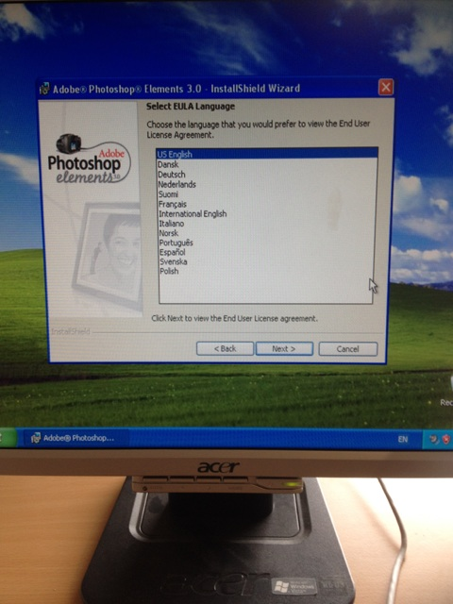
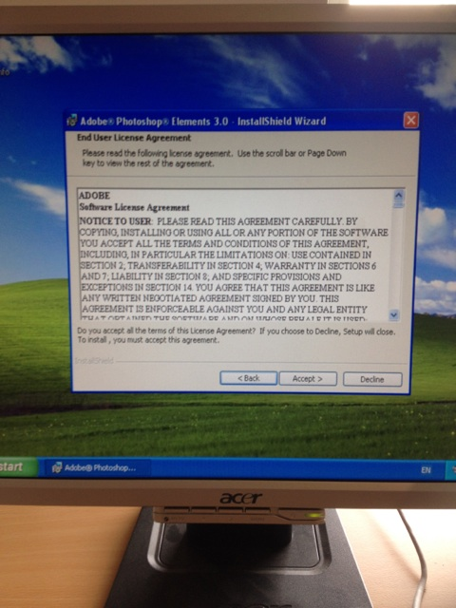
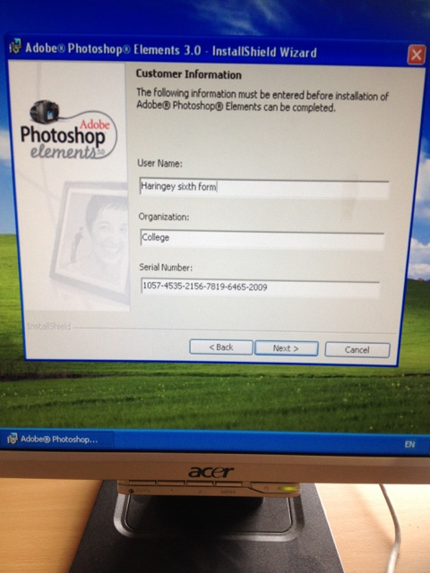
Once again settings for the language will come up but for the end user agreement, then a dialog box will appear asking to accept the agreement, and after you will be permitted to enter information such as a user name, organisation and the serial number that comes with the Adobe Photoshop disk, and proceed to the next step.

Slide 5
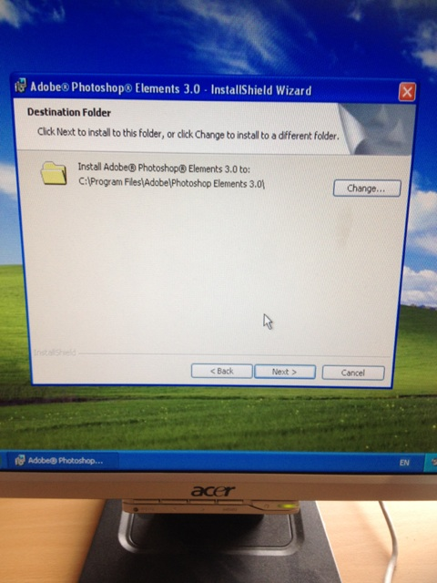
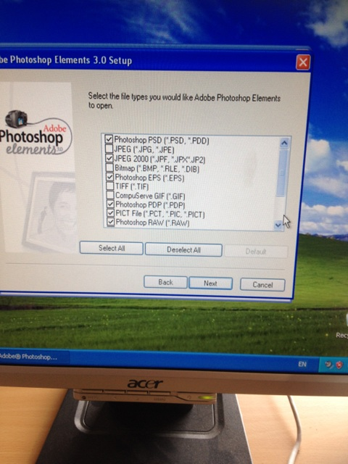
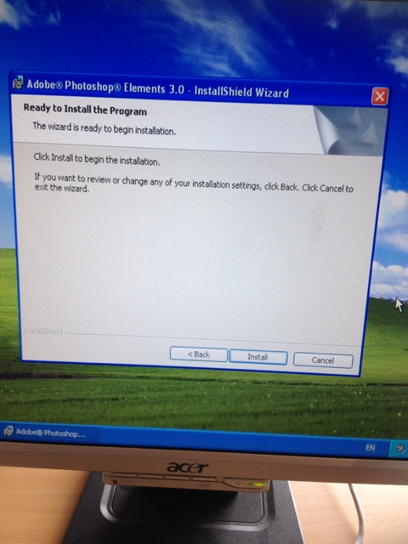
After selecting where you want the folder destination of this software to be installed, you then click next to select which files you want Adobe Photoshop elements to install, and after clicking on next you finally click on install to install the software.

Slide 6
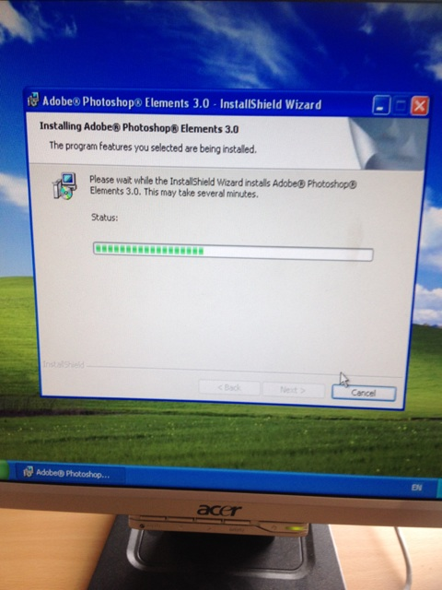
And finally Adobe Photoshop elements is being installed onto the computer.

Slide 7
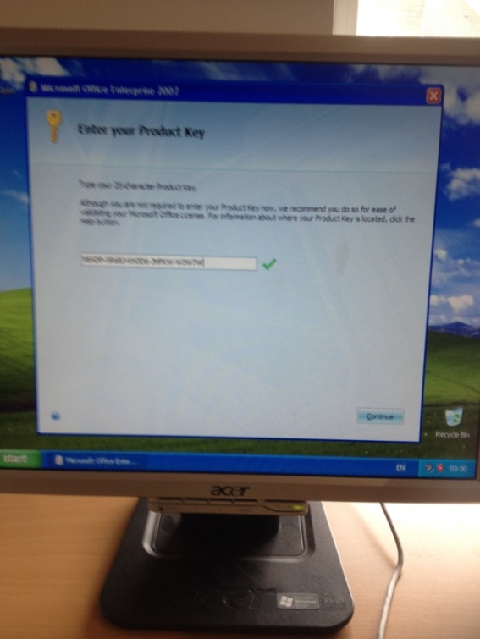
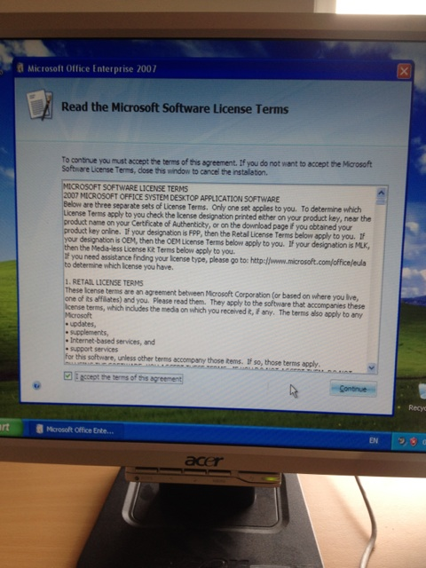
Microsoft Office
In order to install Microsoft Office, it is required that you are to enter a product key to be able to install it. After it has been entered, and you have clicked “continue”, you are to accept the licence terms in order to proceed (by doing so you select tick the box and select continue).

Slide 8
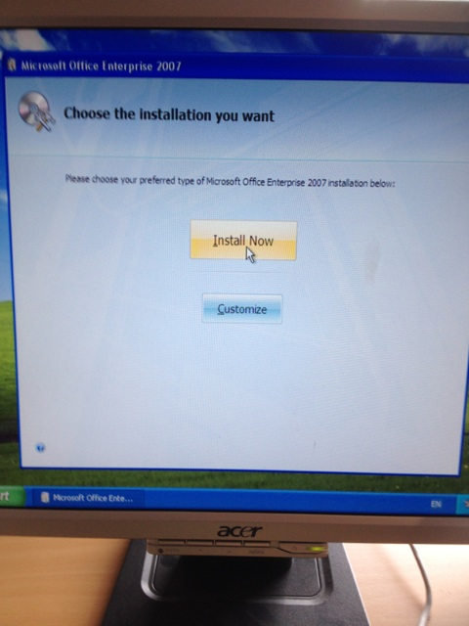
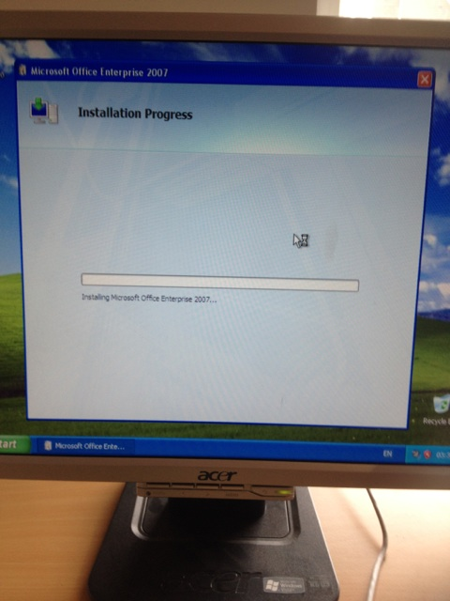
Finally you are able to click “install now” and it will then install the software.

