Slide 1
Copyright
Gladys Nzita-Mak

Slide 2
Copyright is….
Copyright means the right to the author/publisher or distributor of their own work such as publication of for example music that they have released online to sell, or even work that they have written up.
Principles
Always copyright work by having the symbol and a name claiming that the work is yours
Not to give a make copies or to send a copy to anyone
Not to make any copies of anything copyrighted and sell it
Ask permission before using a copyrighted product
And never to rent a copyrighted product without permission

Slide 3
How to comply with the law when you try to use someone else’s image as your own
When using an image that has been produced by someone else, in order to comply with the law, asking for permission to use the image as your own is a way of making sure that you are complying with the law, and not going against copyright.
By sending in an email or letter to the website the picture was taken from, and receiving a response that you are able to use the image freely, makes sure that a person is able to use the image as their own being able to do whatever they wish with it.

Slide 4
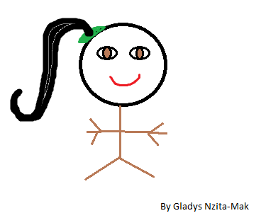
Create a small image demonstrating skills
C

