Slide 1
P5
Gladys Nzita-Mak

Slide 2
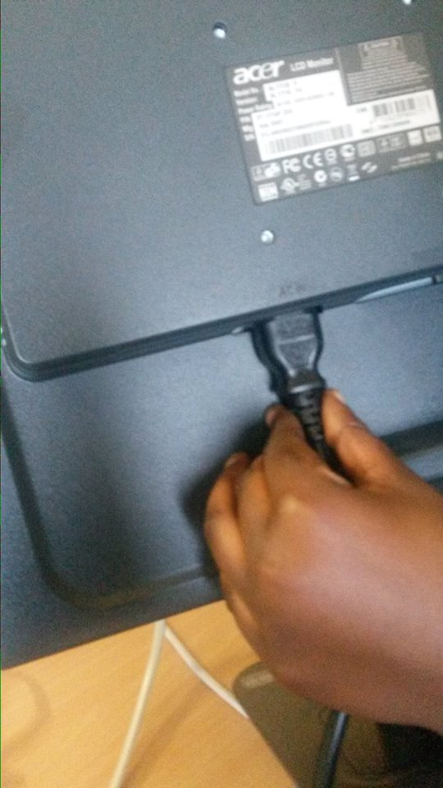
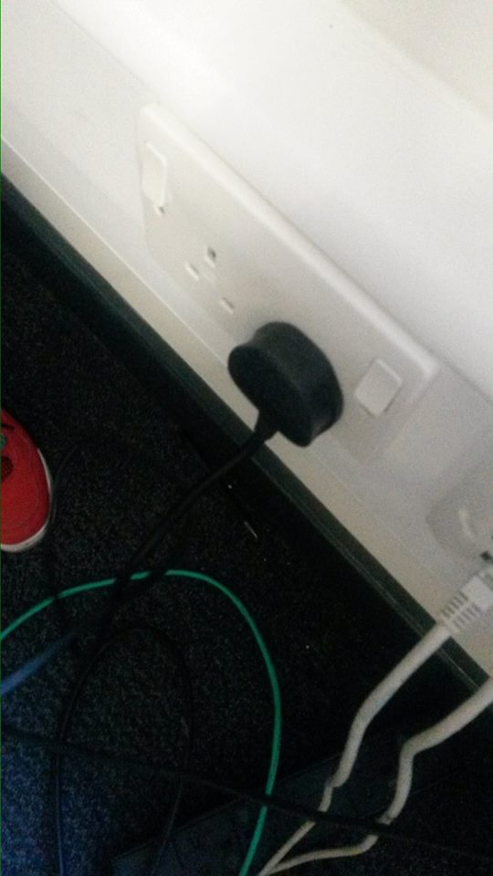
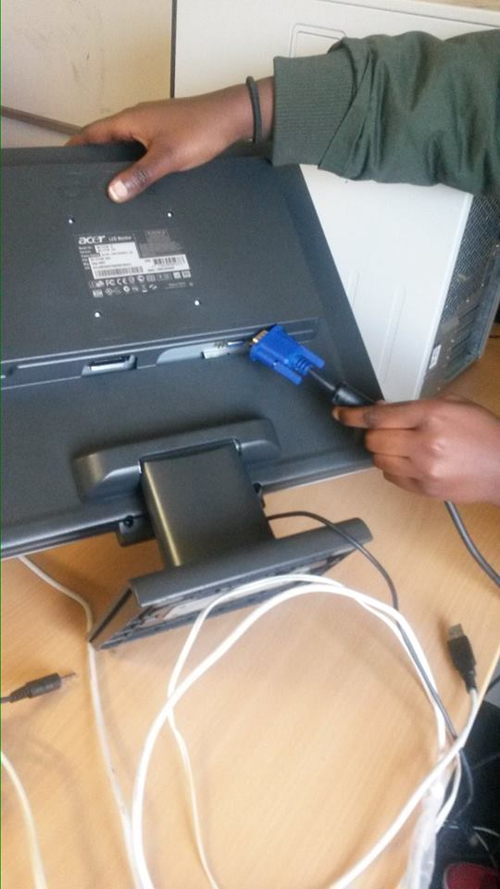
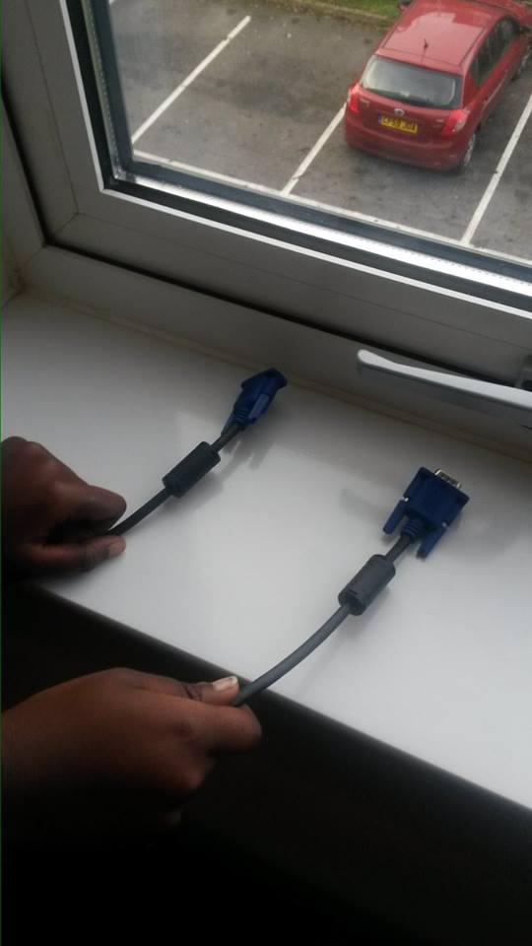
Monitor and plug for monitor
These pictures show the cables that go into the monitor and from the plug

Slide 3
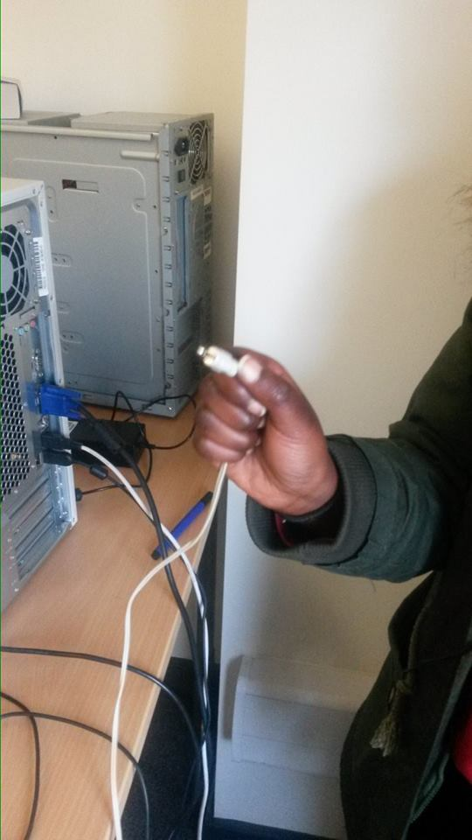
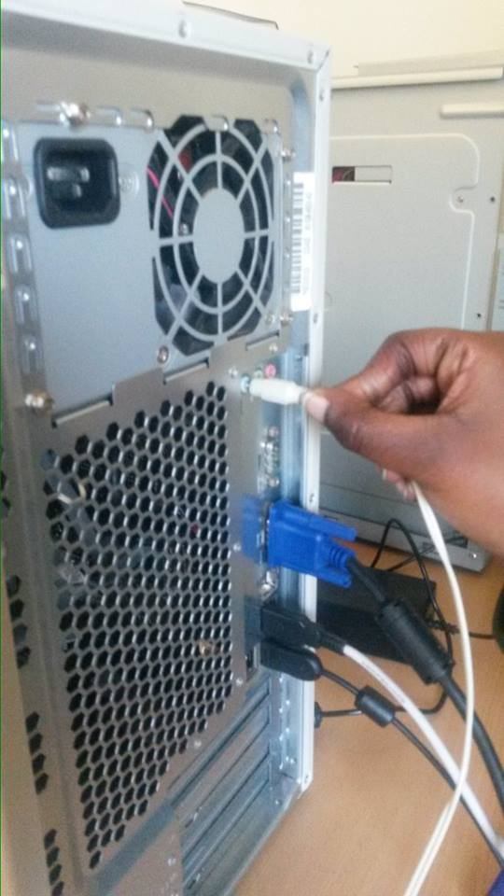
Speakers
The images show the cables from the speakers and being plugged into the computer box

Slide 4
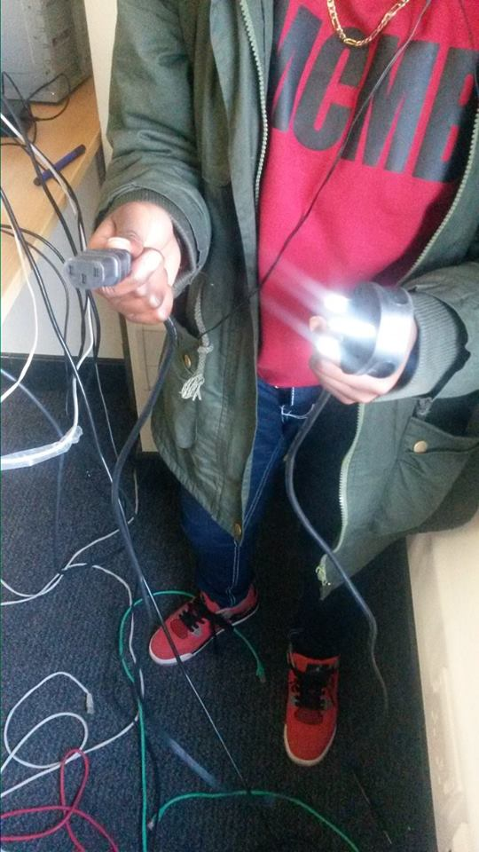
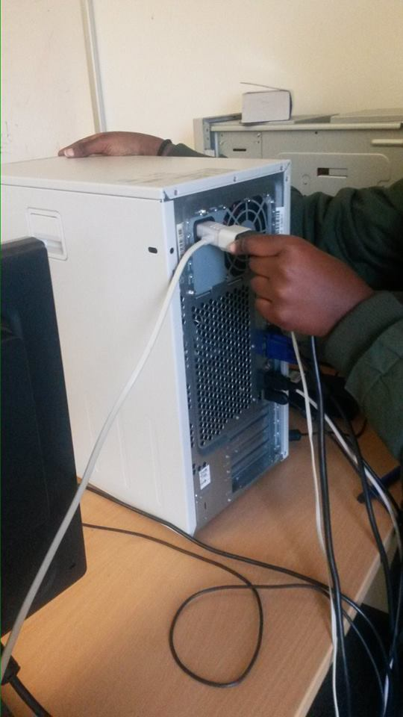
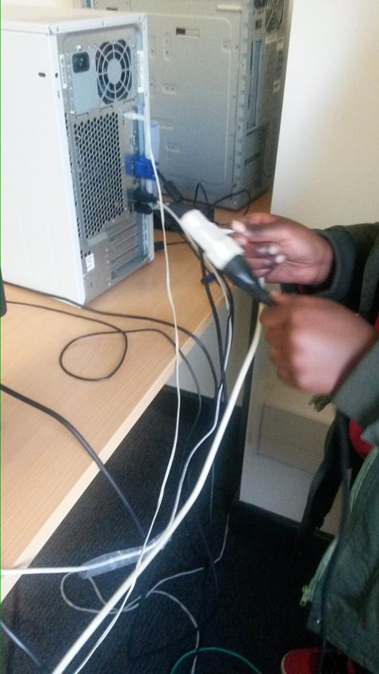
Power
Cables showing the plug from the main socket that go into the computer box

Slide 5
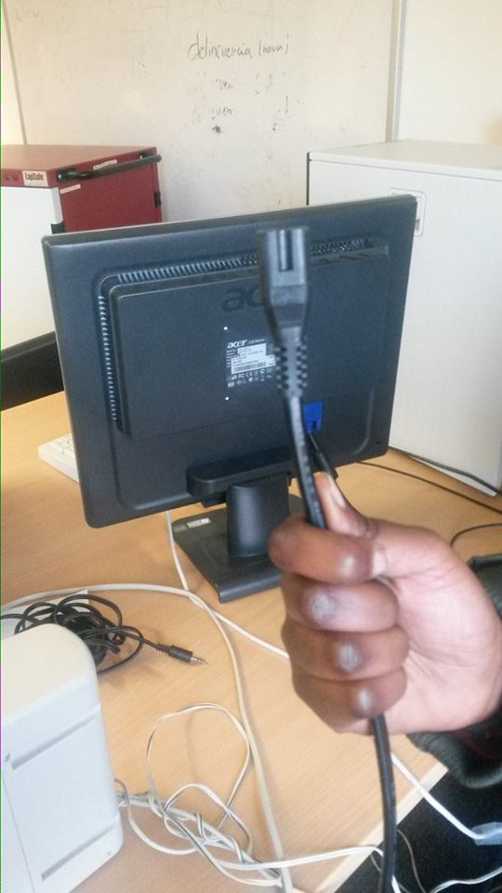
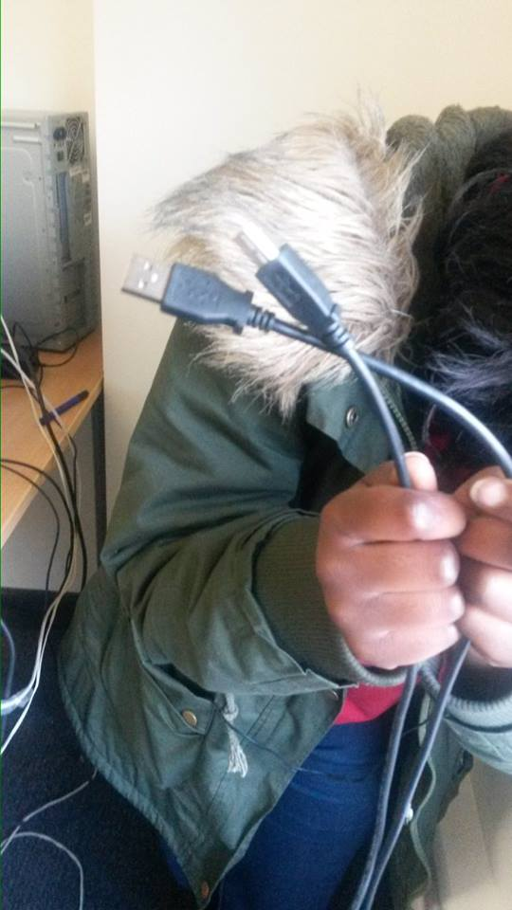
Printer
These are the cables for the printer that connects into the computer box

Slide 6
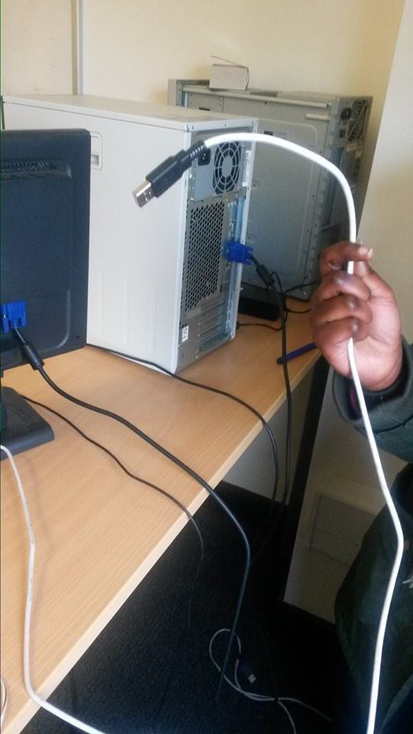
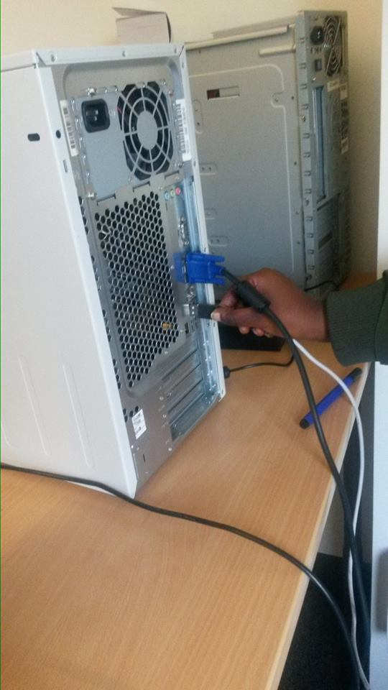
Keyboard
Cables that connect from the keyboard into the computer box

Slide 7
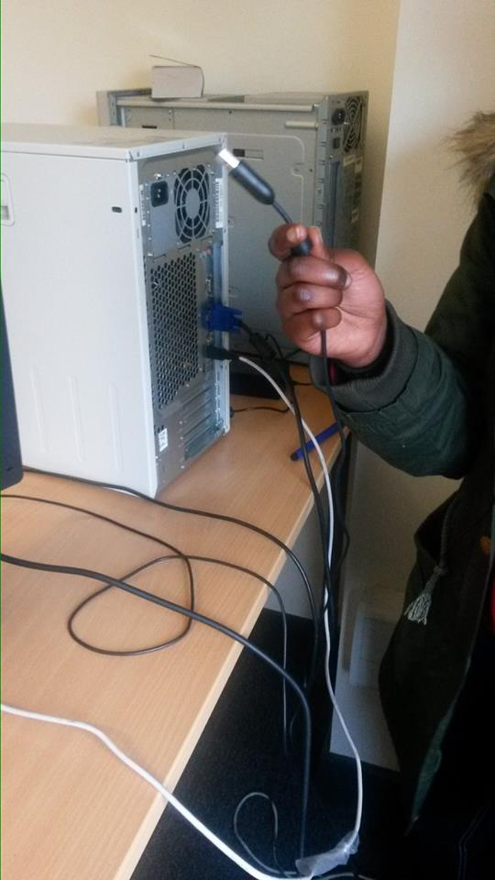
Computer mouse
The cable for the mouse that connects to the computer box

