Slide 1
Techniques and skills
Gladys Nzita-Mak

Slide 2
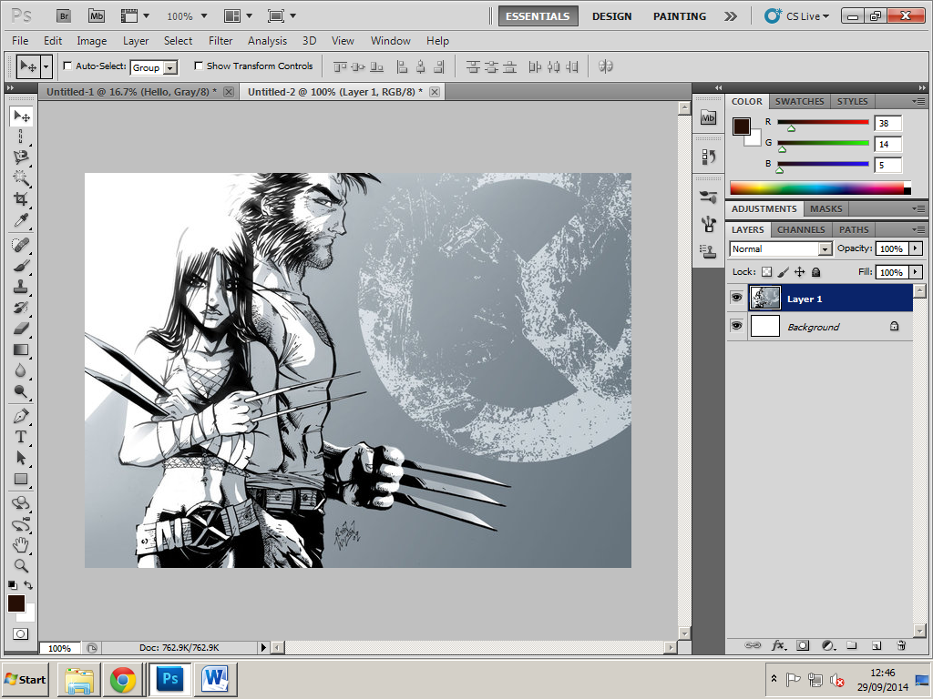
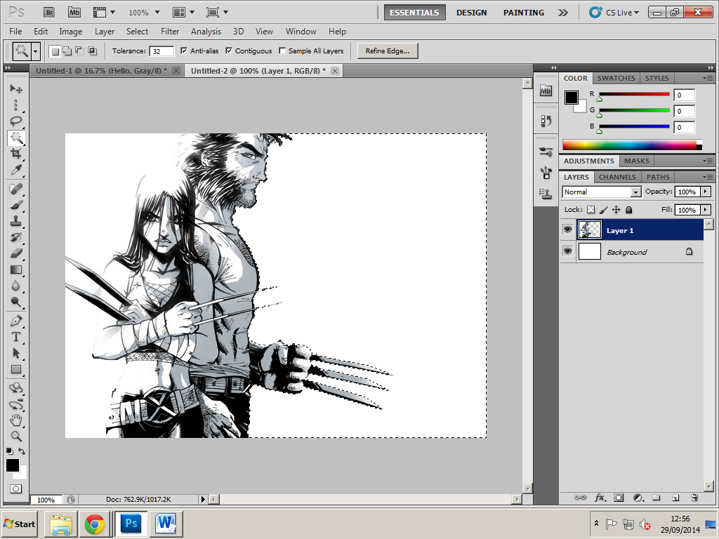
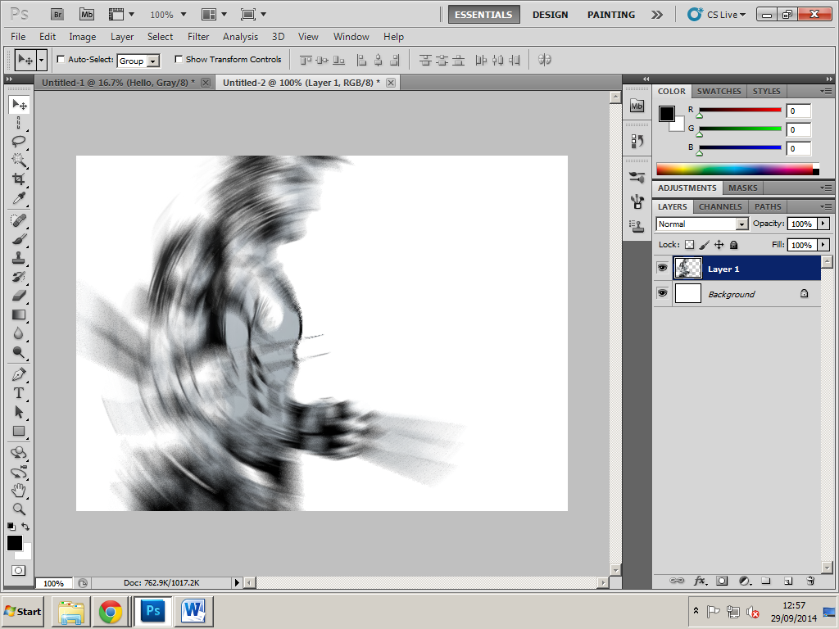
Basic skills
1
Used quick selection tool to remove background
2
Blur tool

Slide 3
5
3
Text tool
Creating a new file
4
Paint Bucket before and after

Slide 4
6
7
Adding a new layer
Eraser tool (before and after

Slide 5
9
8
Magic tool
Creating shapes
10
Brush tool

Slide 6
11
12
Background colour (before and after)
Using different colour styles
Clone stamp tool (before and after)
13

Slide 7
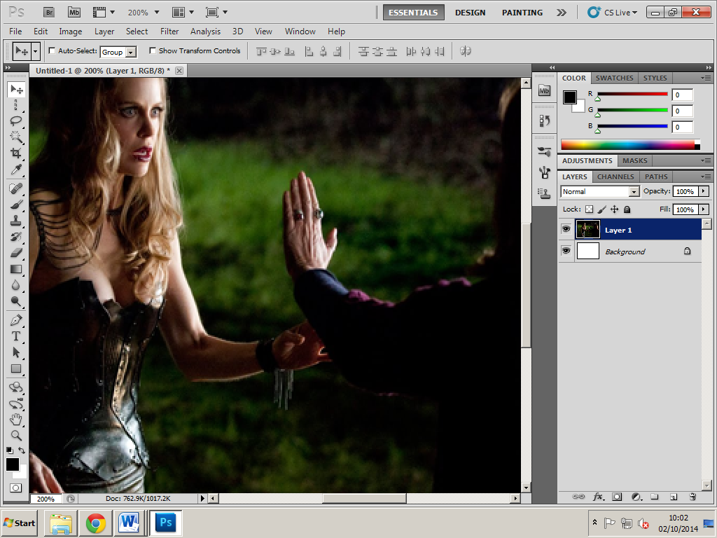
Zoom in (before and after)
15
14
Crop tool

Slide 8
Red eye tool (before and after)
17
Gradient tool
16

Slide 9
19
Drop shadow tool
18
Sponge tool (before and after)

Slide 10
21
20
Magic eraser tool
Burn tool

Slide 11
Advanced skills
Radial blur filter (before and after)
Shape blur filter (before and after)
Average blur filter (before and after)

Slide 12
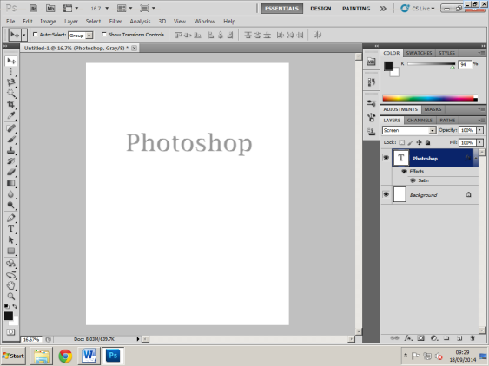
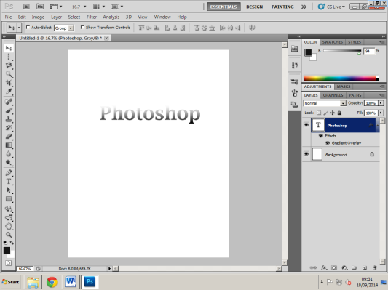
Used the layer styles inner glow and drop shadow
Layer style Satin
Layer style gradient overlay

Slide 13
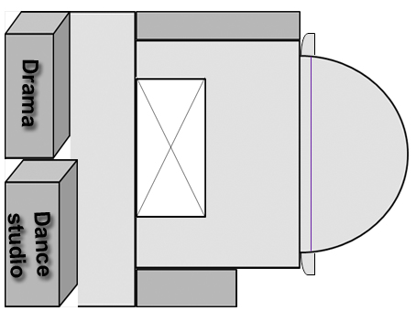
Vector Graphics example

