Slide 1
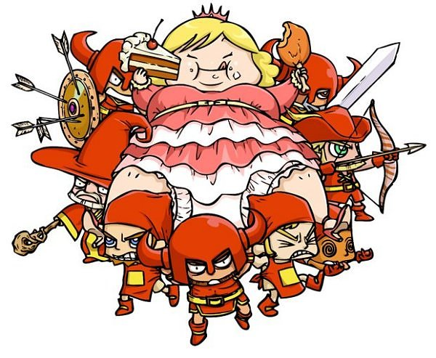
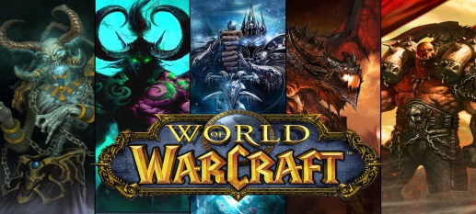
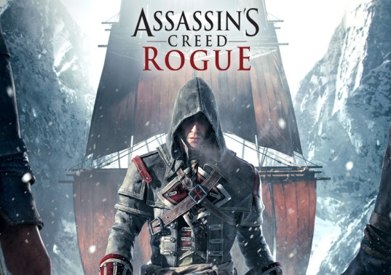
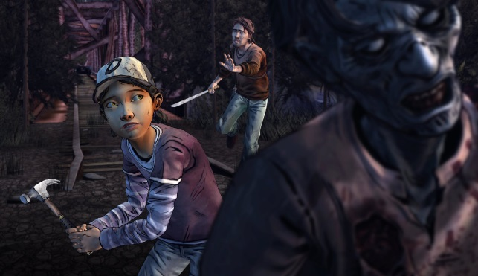
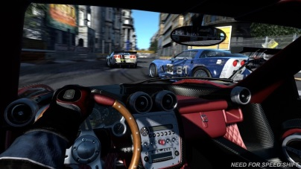
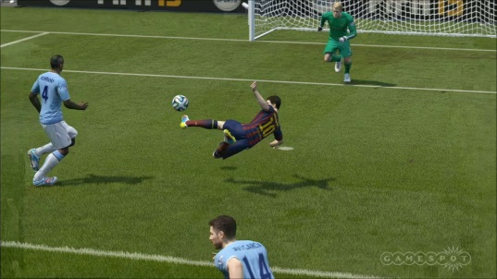
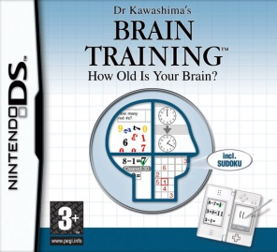
Unit 22 – P2 – Gladys Nzita-Mak
Genres of games
Role-playing games allow players to step into the shoes of their characters, taking part in storylines and developing their characters’ abilities. World of Warcraft is a perfect example as the player will create a character and take part in quests, using magical powers to take part in duels.
Adventure games are games which follow a story with characters both non playable characters and playable characters. They include solving quests and even puzzles and usually include a range of min games.
A strategy game relies on players to be tactical with their thinking and decision making. For example the game Fat Princess relies on user to use their thinking skills.
Action games are games that set out missions and challenges which require a players’ quick reflexes and thinking skills in order to complete them.
Simulation games simulate real life encounters into virtual worlds, for example racing car games like Need for Speed are simulated to make the player feel like they are in an actual car driving, controlling gear shifts and really stirring the wheel.
Educational games are made to improve skills based on the subject it is based on, for example schools would often allow kids to take part in maths games to improve their mental ability. For example Dr Kawashima’s Brain Training is a Nintendo ds game that is created to enhance a player’s ability in educational subjects such as math.
Sports games like Fifa allow players to select and control teams and players, being able to take part in games, kicking around a football just as real life football games are done so.
Combat games have players using characters in first person view, and having combat and weapons a main element of a game. For example Time splitters is first person and is based on shooting other characters as the main goal of the game.

