Slide 1
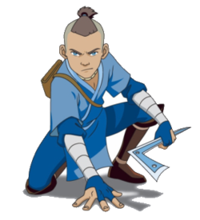
Outline ideas
Gladys Nzita-Mak

Slide 2
Ideas
Characters
Aang
Katara
General Ozai
Firebenders
Scene
Village
Courtyard
1. General shouts order
2. Firebenders attack Aang
Plot
6. Firebenders flee
3. Aang gets attacked
4. Katara flips out
5. Katara attacks firebenders

Slide 3
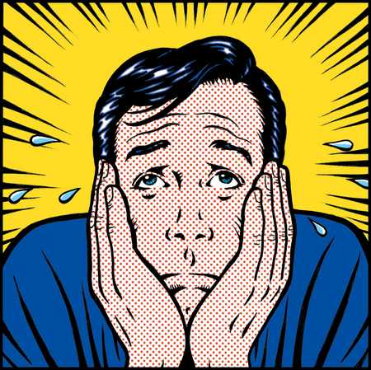
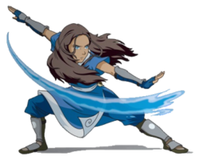
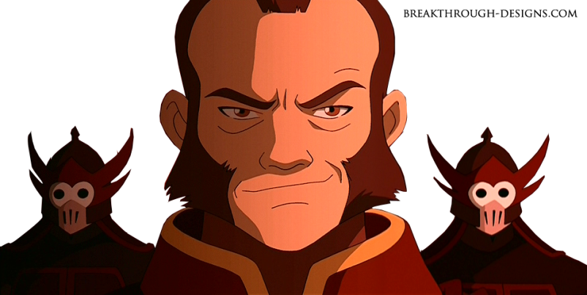
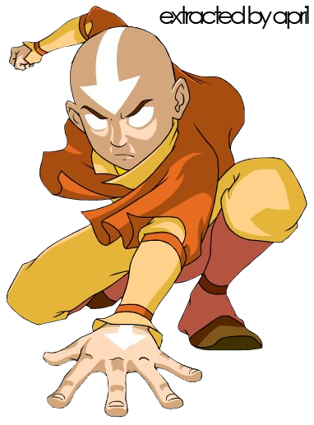
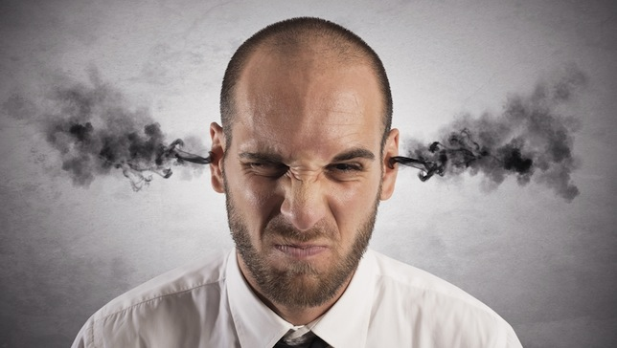
Mood board

Slide 4
Storyboard

Slide 5
Storyboard

