Slide 1
Web animation
Gladys Nzita-Mak

Slide 2
Uses of web animation
Banner ads
Promotion
Instruction
Information
Entertainment

Slide 3
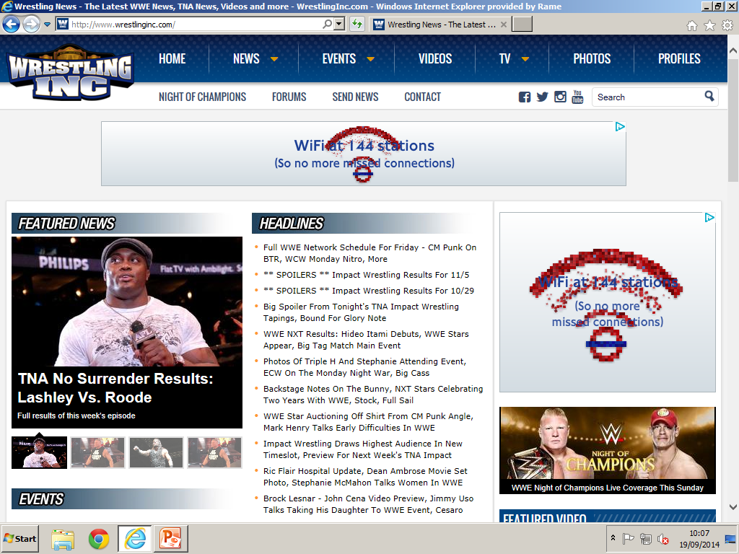
Banner ads
Banner ads are used on websites as promotions, promoting other websites or even new games or films that are being released. Banner ads can simply be text with graphics, or can be more advanced by having animations and sounds added onto them. Banner ads are interactive, and some can be dictated by cookies found in a users search history. For example in the image below, the banner ad at the top of the page is a TFL advertisement that has the red Wi-Fi sign animated to attract viewers on the page to click on the advertisement.

Slide 4
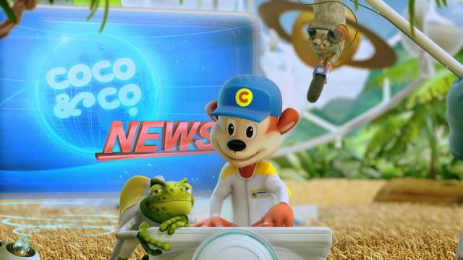
Promotion
Animation can be used to advertise products for companies such as on TV, Kellogg's use animations to promote their cereals to kids in order to attract them to their products. The reason for using animations for promotion is to attract wider audiences to whatever is being promoted, having more people aware of the promoted product. In the image below, one of Kellogg's popular cereal advertisements for coco pops use CGI for their animations.

Slide 5
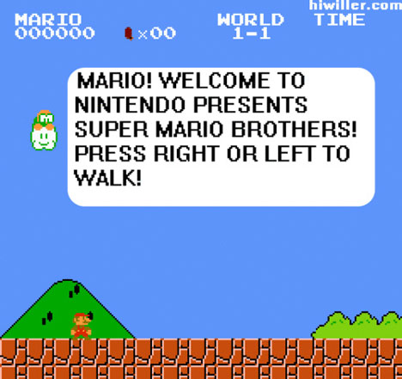
Instruction
In games, animations can be used to describe to a player how a game works instead of just having plain text to inform them. For example, in the game below Super Mario, it has instructions for the player to move the character left or right, and if the player were to press it, it would move left or right. Whilst giving instructions it is animated by flashing/popping up to the user as each instruction follows.

Slide 6
Information
An animation can be used as information in for of advertisement or even in work presentations, for example an animation informing the public not to smoke, by so they could use a no smoking animation just for effect, in the image below, the cigarette's smoke is animated as it is burning.

Slide 7
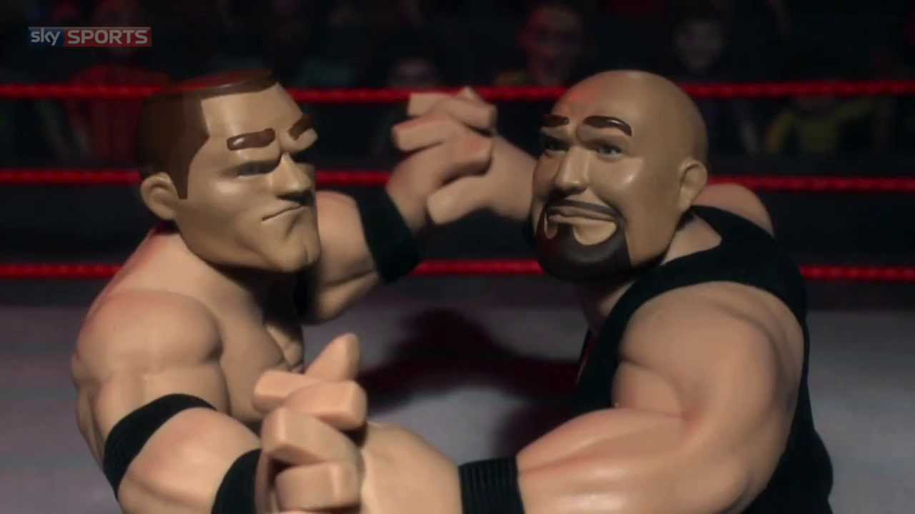
Entertainment
In entertainment, animations is used in games, TV shows and on websites. For example WWE airs a new animated series called WWE Slam City, which uses claymation in order to attract the younger viewers to watch the show.

Slide 8
Principles of Animation
Persistence of vision
Hand drawn
Claymation
Stop motion
Animated cartoons
Flip books

Slide 9
Persistence of vision
Persistence of vision is a trick of the eye, as it allows the brain to remember a movement, followed by another movement and preserves it for a short amount of time. It gives the sense of motion/movement when looking at images that are closely-timed. If there were no persistence of vision, animation would just be seen as a set of pictures.

Slide 10
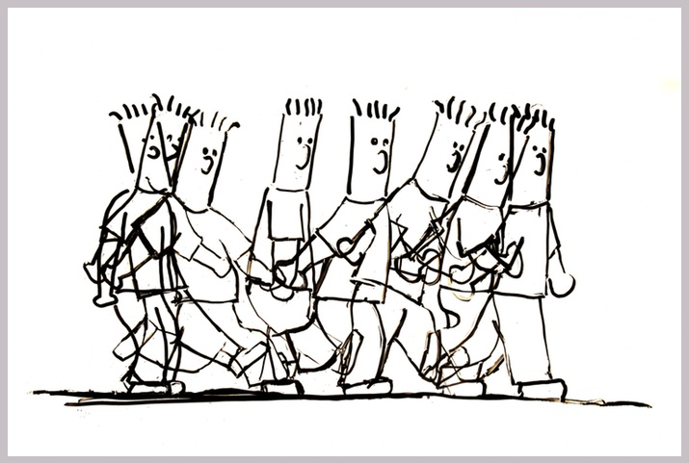
Hand drawn
This type of animation is a technique of drawing images by pen and paper and using it as an animation, for example in the image below is a hand drawn animation of a person walking, showing all the stages exactly of the persons’ movement.

Slide 11
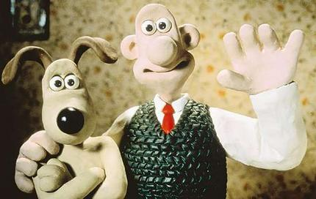
Claymation
Claymation is having clay and sculpting it into an object such as a person, which can be moved frame by frame to make an animation. This can be done by the use of still images. For every still image taken, the object has been moved in every still and once played back, it creates the illusion of movement. For example, the cartoon show “Wallace and Gromit” is a show made by claymation.

Slide 12
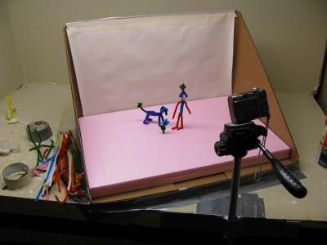
Stop motion
Stop motion is the technique of having an object such as either clay or a simple figure like a toy, and bringing it to life by taking small shots of video moving the figures slightly frame by frame creating an animation. In the image below two figures (a dog and a man) are being set up for stop motion animation with a stage and a camera ready to shoot.

Slide 13
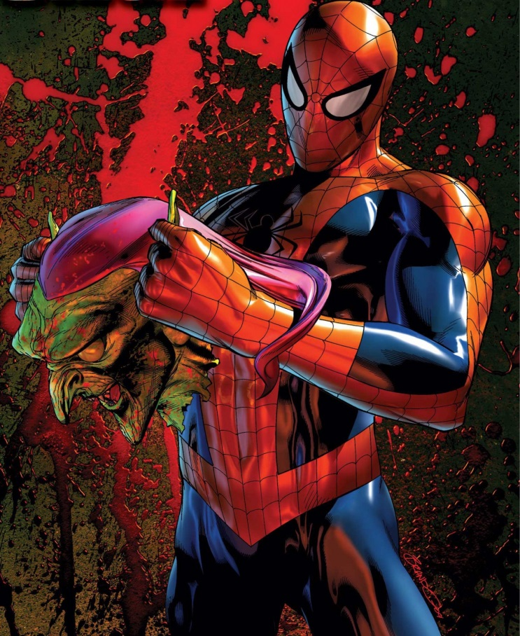
Animated cartoons
Animated cartoons are motion pictures or television films that consist of drawings, objects and even graphics from computers which are simulated into movement in frames. The ultimate Spider-Man is a popular animated cartoon.

Slide 14
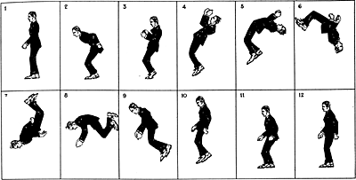
Flip books
Flip books are a series of images in an animated sequence which when flipped through, create the illusion of movement. The image below shows a sequence of images of a man doing a backflip, so when flipped through in an actual flip book, the animation of the backflip will be shown.

