Slide 1
Image processing
Gladys Nzita-Mak

Slide 2
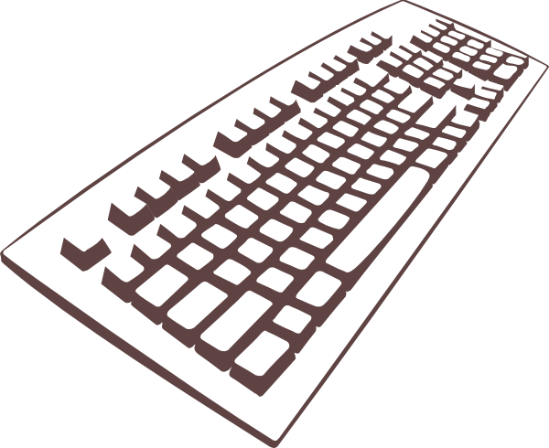
Input devices
A mouse is used to interact with your computer, the user is able to move the mouse, click and select objects and scroll up and down a page. In image processing, a computer mouse can be used to draw images, select and use tools such as crop, rotate and transform images.
Everything that is done on the mouse is seen on the LCD monitor connected to the computer (the monitor is the output).
Its functions for image processing are to edit, copy paste and delete images.
A keyboard is used for being able to communicate with the computer. It is used to input information into your computer. When image processing, keyboards can be used to add text to images, and can have it’s keyboard shortcuts such as in Photoshop to transform an image the shortcut is “CTRL + T”, or to zoom in and out of images users can use “CTRL + or –” to zoom in and out of images.
Functions for image processing is to add text to images, as well as using the keyboard for shortcuts.

Slide 3
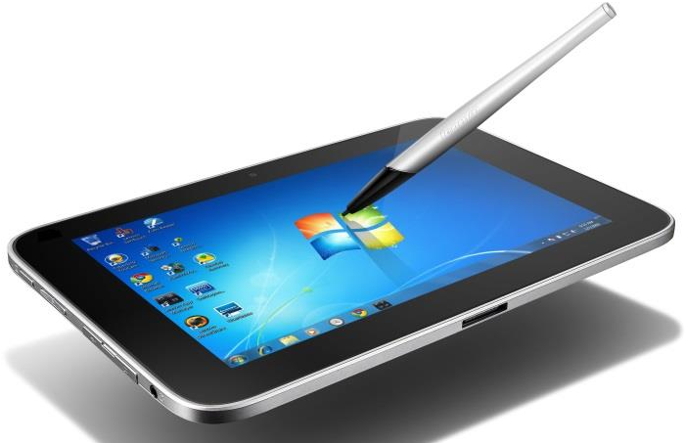
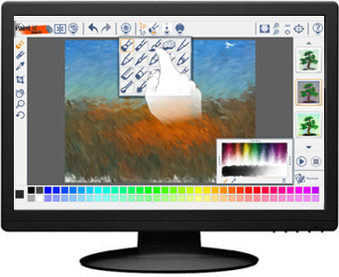
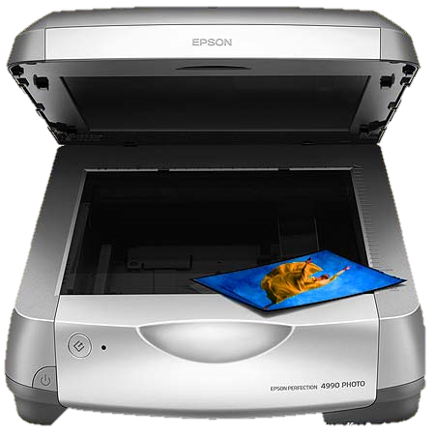
By using touch screen, it enables the user better interaction with their computer, allowing users to touch areas on the screen being able to navigate and use it sort of like a handheld device which can be very useful for image processing.
Tablets are portable computers that users are able to input text, and other information into it only by using the screen instead of a keyboard or mouse, in this case it would be useful for image processing as users can use pens or their fingers to draw images, and with a tablet manage images more hands on. A tablets’ functions for image processing is the use of a camera (being able to take a photo and edit it), touchscreen to draw images, and also the fact tat it is a handheld device, being able to use it in any way possible, for example flipping the screen over to use it landscape or portrait to edit images.
A scanner is an input device that scans images and documents into a PC and allows the user to use it as digital data, The main function of the scanner in image processing is that a user can scan an image and use an application such as Photoshop to manipulate it.

Slide 4
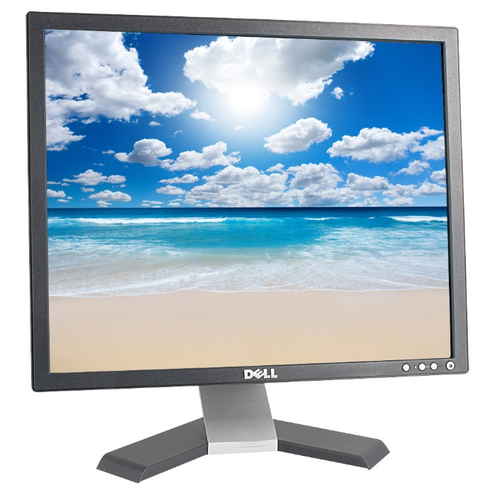
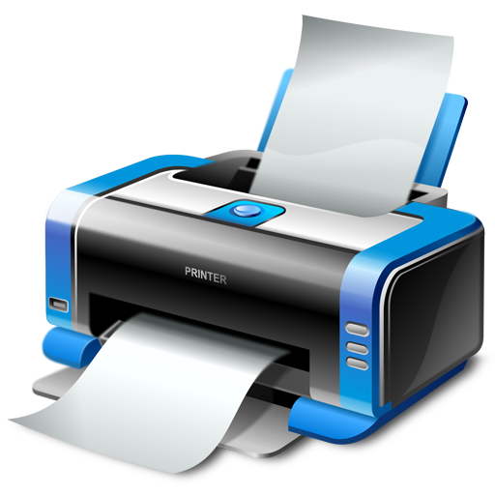
Output devices
After editing and manipulating images, printers are used to transfer on-screen images (or documents)onto paper. There are two types of printers, inkjet and LaserJet printers. For personal prints, inkjets are recommended, whereas LaserJet printers would be recommended for workplaces, and if users would like to print large amounts of work. The main function of a printer in image processing is to print out a copy on paper as a physical copy, being able to preview work in person rather than on screen only.
A computer monitor is an output device that outputs information that has been given by the mouse or keyboard (input devices). When it comes to image processing, users would benefit from having the best PC monitor with high resolutions and quality whilst editing images, as it provides them with a clearer view of their image. Functions of the computer monitor is that it can provide users with good resolutions whilst viewing and editing images.

Slide 5
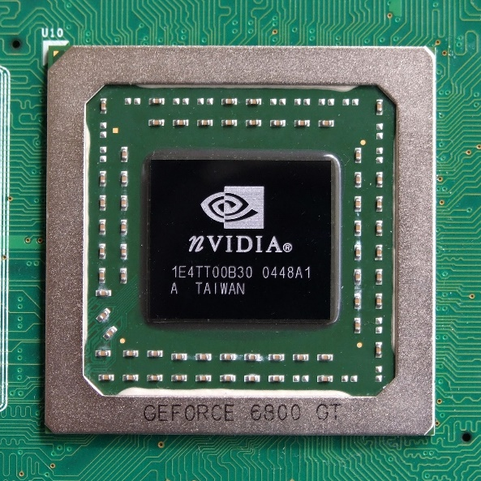
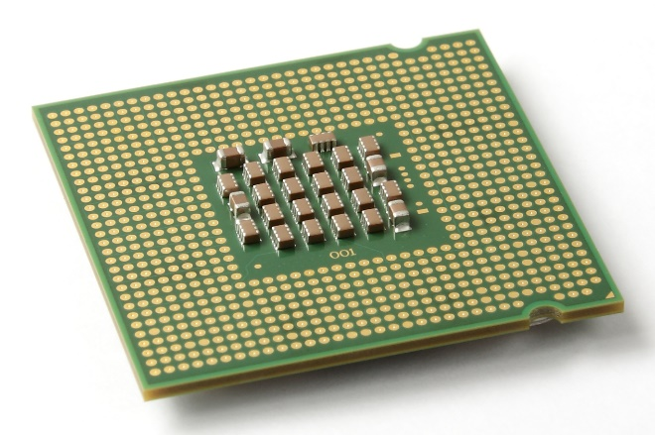
Processing devices
The CPU is the most important processing device as it processes all information from the computer and input devices in order to give an output, therefore its main function is to process images once clicked to be viewed, displaying them on-screen.
The Graphics Processing Unit is a chip that can be put into the motherboard which then enhances image quality, making everything sharp, clear and more detailed. By having a GPU it allows the CPU to process other applications, whereas the GPU will focus on image processing performing calculations on them and other media.

Slide 6
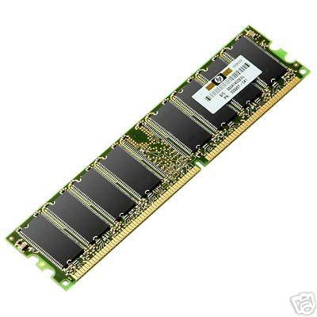
Storage
RAM is used when opening a program or application, it stores temporary data that is being used, for example if editing an image on Photoshop, the work that is being produced will be stored in the RAM temporarily (this is the main function RAM does for image processing). The more RAM the better, and more speedier performance from the PC.
A hard drive stores all its main storage such as documents and media. It is the largest storage component of a computer. With image processing, images and videos can be stored onto a computer that contains a lot of GB, being able to save hundreds of images, and lots of videos, and with it being saved on the hard drive, users can access images, and preview them when needed.

Slide 7
Microsoft Visio
Microsoft Visio is an application which uses vector graphics to produce diagrams.
Tools:
Shape tool, fill, text, formatting tools such as changing font, formatting, colour and line style. Align, rotate, change and connect shapes. Transparency, shadows, crop tool, snap and glue, stencils, pan and zoom, size and position,
Features:
Quick shapes toolbar, enhanced dynamic grid, automatic layout adjustment, page auto size, liking diagrams to dynamic data, and collaborating easy.

Slide 8
Adobe Photoshop
Adobe Flash Professional is an authoring program used for creating 2D games, animations, web applications and content for mobile phones.
Features:
HTML5 Canvas support
Improved HTML publishing
64-bit architecture
Sync settings
Simplified user interface
Testing and debugging via USB
Timeline time-savers
Unlimited pasteboard size
Powerful code editor
Real-time drawing
Custom metadata APIs
Wide platform and device support
High efficiency SWF compression
Rendering
Tweening
Controls
Debugging
Tools:
Move tool, Marquee tool, Lasso tool, Magic wand tool, quick selection tool, Crop tool, eyedropper tool, spot healing brush tool, brush tool, stamp tool, history brush tool, eraser tool, gradient tool, blur tool, dodge tool, pen tool, text tool, path selection tool, rectangle tool, object rotate tool, camera rotate tool, hand tool, zoom tool.

Slide 9
Ms word
Microsoft word is a word processer that allows users to produce documents.
Features:
Spell check, grammar, different fonts and sizes, WordArt, Bullets and numbering,
Tools:
Open file, cut and paste, text, macros, word count, XML, controls, shapes,

Slide 10
Image viewer
The image viewer in Microsoft allows users to preview their images, being able to make decisions on their images such as setting it as the desktop background, or simply, just rotating the image.
Features:
Print, email, burn, open, set as desktop background
Tools:
Zoom, left, right, rotate (left and right), delete, copy and properties

