Slide 1
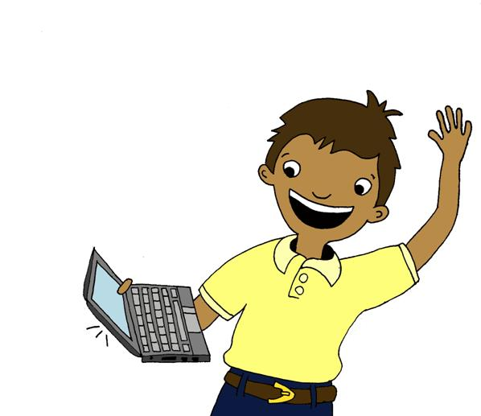
Origins of animation
Gladys Nzita-Mak

Slide 2
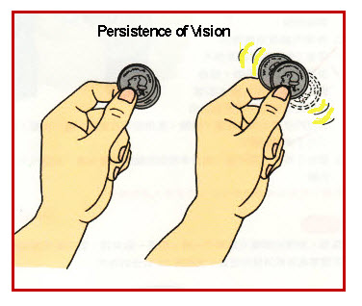
Persistence of vision
Persistence of vision is a trick of the eye that enables the brain to remember a previous movement followed by another movement and to preserve it for a short amount of time. Persistence of vision relates to animation because it gives the sense of motion/movement when we look at images that are closely-timed. Without persistence of vision, animation would just be seen as a set of pictures.

Slide 3
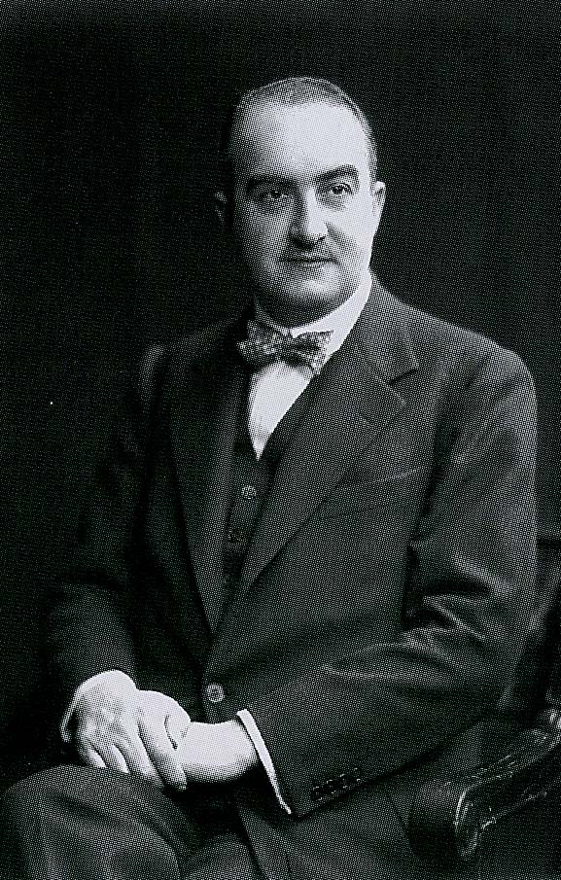
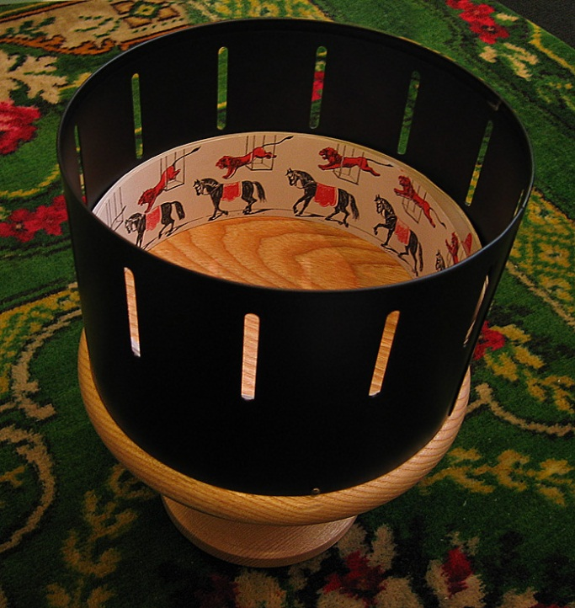
William Horner
William Horner is the inventor of the ‘daedalum’ (wheel of the devil) now known as the ‘zoetrope’(wheel of life).
The zoetrope is an animation device. It has slits cut into in them and animation strips are placed onto them. As the zoetrope is spun, by looking through the slits you can see the pictures moving like an animation.

Slide 4
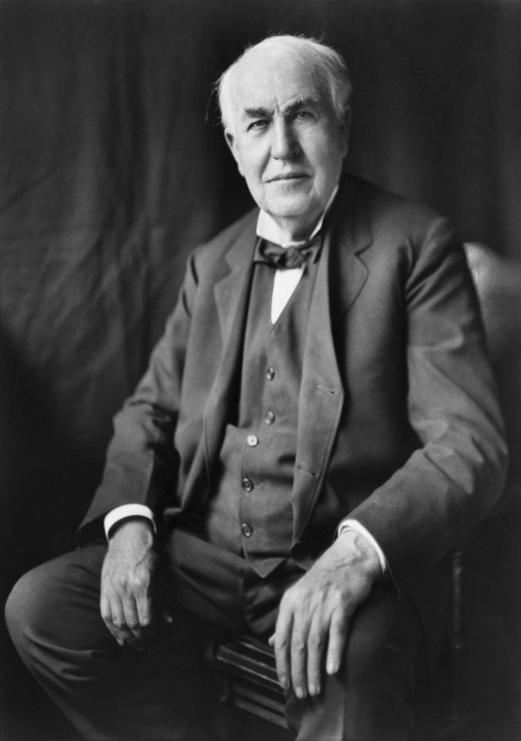
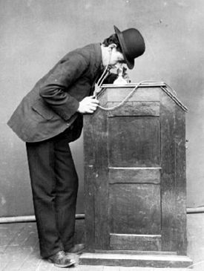
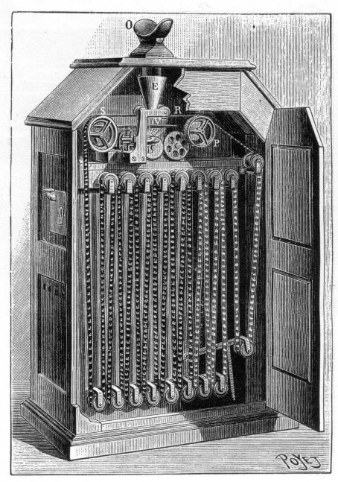
Thomas Edison
Thomas Edison invented the Kinetoscope, it is an invention that a person is to look into a small peep hole to view the motion pictures. It gives an illusion of animation by using a strip of film with images and was run over light and a high speed shutter.
In the pictures you can see a man looking into the peep hole viewing the motion picture, and in the next picture you’ve got a full view of the Kinetoscope and is able to see the shutter that (in a way) rotates the filmstrips giving animation.

Slide 5
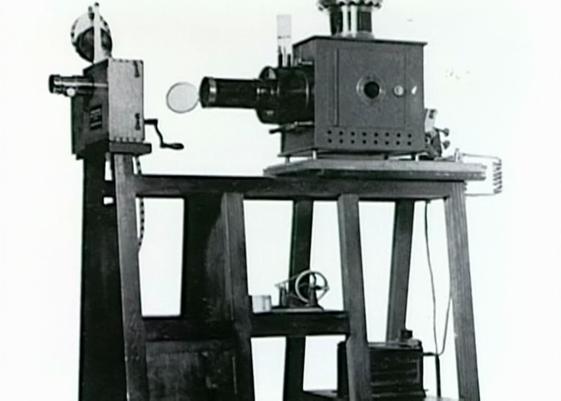
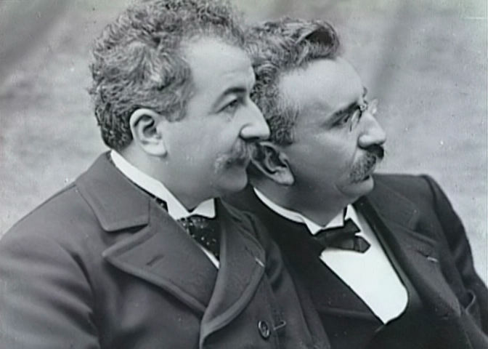
Lumiere brothers
The Lumiere brothers invented the Cinematograph, a camera that is portable and that can film, process and project all in one. This invention is important in animation because it used to project films that have been recorded. It was used in a way to project films onto screens, but back then it was only able to play up to 50 seconds. It said to have changed cinema history. Today it has been evolved and can be used in theatres to project films.

Slide 6
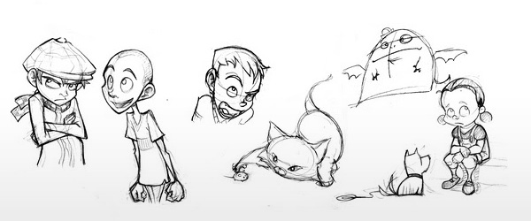
Traditional methods of animation

Slide 7
Drawn animation
Drawn animation is when the animators draw each and every frame of a film.
This could be shown as a flipbook. Each frame is drawn onto a single page, and when flipped fast they make an animation.

Slide 8
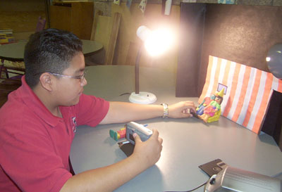
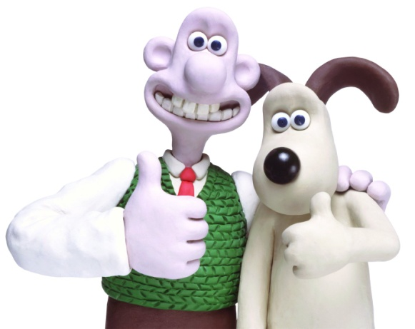
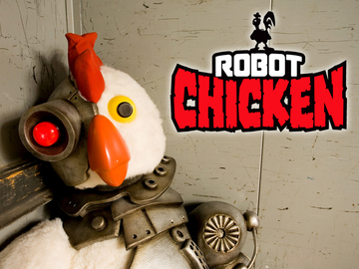
Claymation
Claymation is the use of objects sculpted into clay and moved frame by frame to make an animation. This can be done by the use of still images. For every still image taken, the object has been moved in every still and once played back, it creates the illusion of movement.
Shows like Wallace and Gromit and Robot Chicken both use claymation. Although Wallace and Gromit is a claymation production, it also uses stop-motion animation. Stop-motion animation is used to make the objects/characters seem as if they’re actually moving on its own.

Slide 9
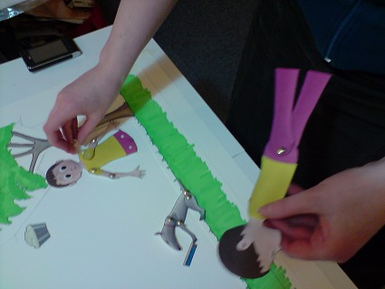
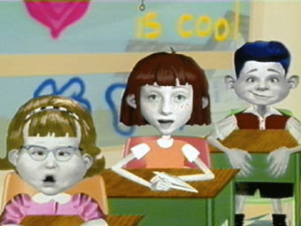
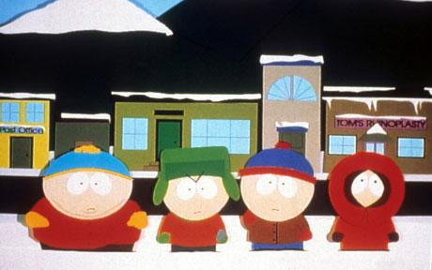
Cut-out animation
Cut out animation is using materials such as paper, card or even photographs producing animation. With the materials listed, cut-out animation involves using flat characters, props and a background. It is an easy process, but is time consuming. It is done in the same process as claymation, by using still images to create an allusion of movement.
Angela Anaconda (the TV show) is a good example of cut-out animation. And also South Park’s Pilot episode was made as a cut-out animation, using props like paper, cardboard and a background.
Today Cut-out animation is now produced with computers

