Slide 1
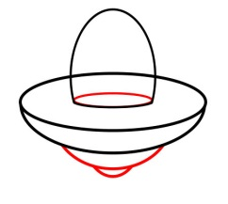
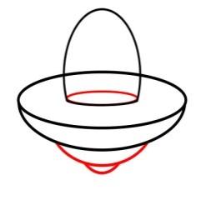
Gladys Nzita-Mak - Storyboard
Lives
Score
0
4+2
4+2
6
Here is a simple spaceship, and in the window you are to type in your answers to allow you to shoot your enemies
When the enemy comes forward, in order to shoot you are to enter the answer into your spaceship
When you type in the correct answer (e.g. 6) the spaceship allows you to shoot
Score
10
Score
5
4+2
6
- - -
8
Once you have shot your enemy will blow up/die and your score will increase
However, if you type in the wrong answer or waste time, the enemy will get closer and closer to you
If the enemy is close to you and manages to touch you, you will blow up and a life will be taken away and also lose points, and so a new enemy will appear

Slide 2
Space maths game
The enemy will have a simple math question for the player to answer, if the player selects the incorrect answer they will blow up!
12/02/2014
Gladys Nzita-Mak
Correct!
4
4+2
4
4+2
6
6
Here is a simple spaceship, the player will control this ship
There will be one question (as shown in the ship), the player will use the ship and direct it to the correct answer
When the player selects the correct answer a sign (Correct!) will display letting them know they selected the right answer
Correct!
Wrong!
Wrong!
4
4
4+2
4
4+2
6
6
6
And as they have selected the correct answer, the Ship will blow up
However, if the wrong answer is selected then the word “Wrong!” will appear
And as the wrong answer is selected the players spaceship will blow up!

