Slide 1
Routine maintenance activities
Gladys Nzita-Mak

Slide 2
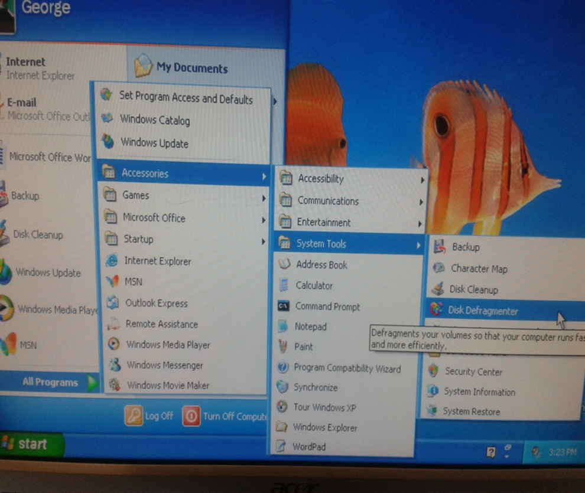
Disk defragmentation
To get onto the disk defragmenter, I firstly went to the start menu and followed onto “accessories”. I then went on to highlight “system tools” so that is can give me options like backup, or disk clean up. Underneath disk clean up is “disk defragmenter” and once I clicked it opened up a box which offered for me to analyse the computer, and once clicked it opened up a message letting me know that I do not need to defragment the computer.

Slide 3
File management on a USB
On a USB I accessed my “ICT Work” folder by double clicking it. Inside 4 files have already been created with files inside, and by clicking on a folder “Georges work” you can see the files that are inside.

Slide 4
File management on a network
To access files on a network, you can select any folder in your documents (in this case I chose ICT) and double click them to open up. I then selected a file folder called “Austin Ononaji” and inside I had my organised files.

Slide 5
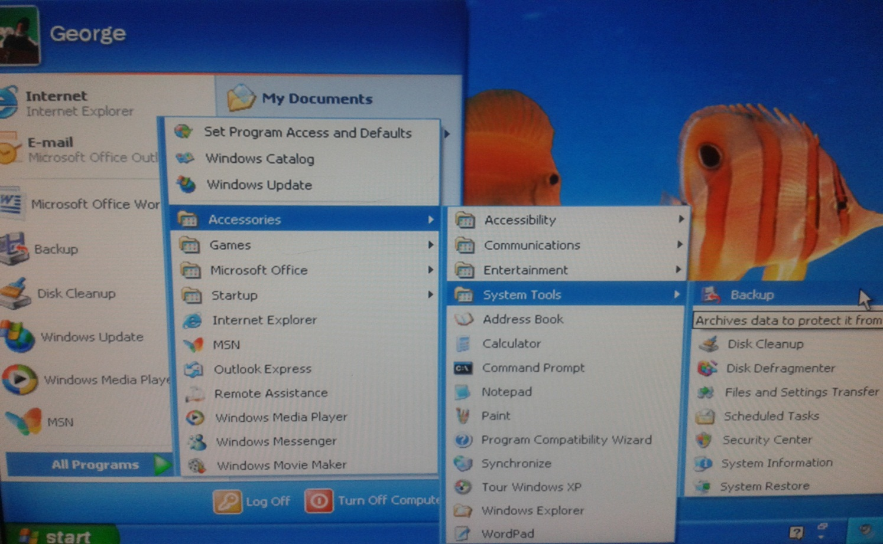
Back up
When it comes to backing up your computer, you have to access it by going to the start menu, then going onto accessories, then system tools and click on “backup”

Slide 6
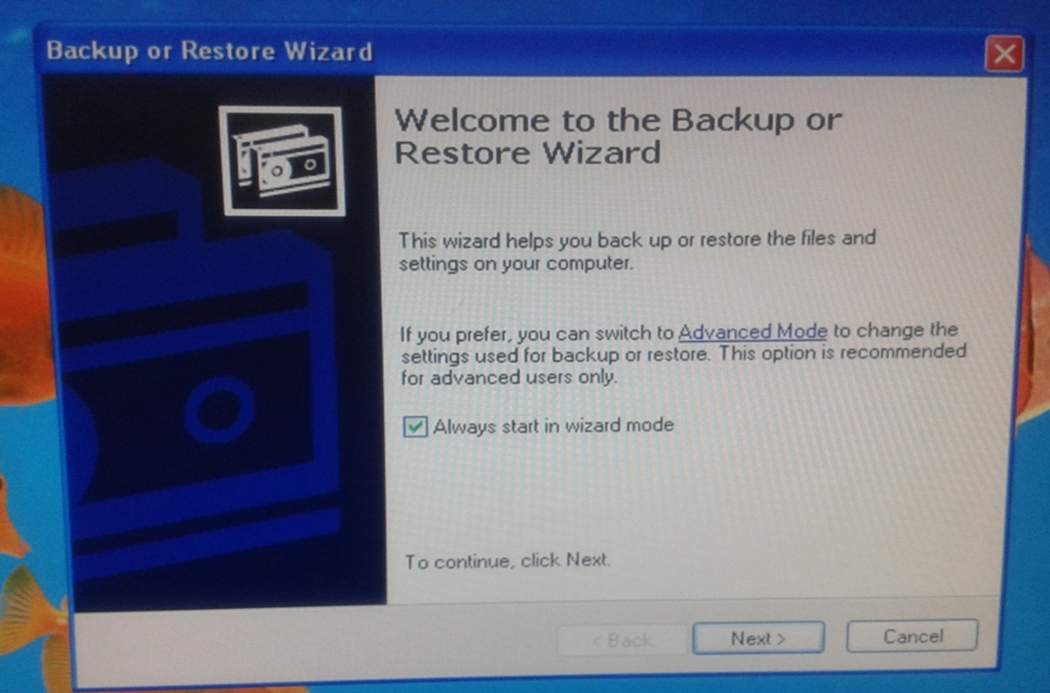
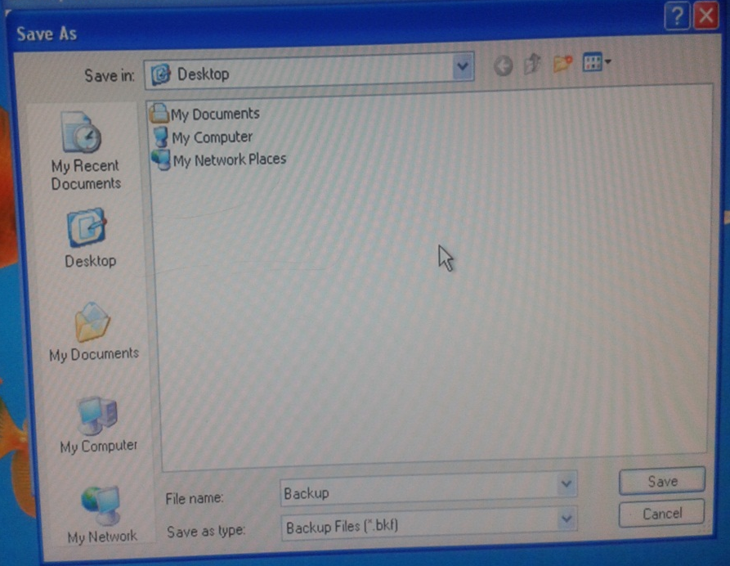
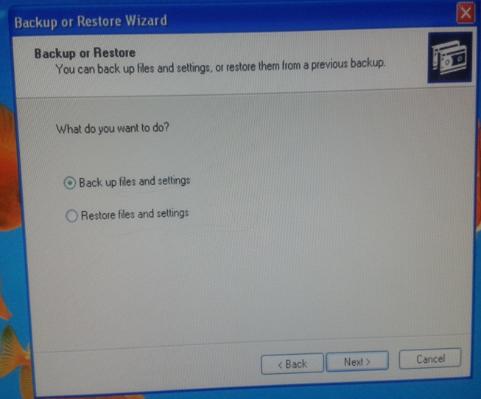
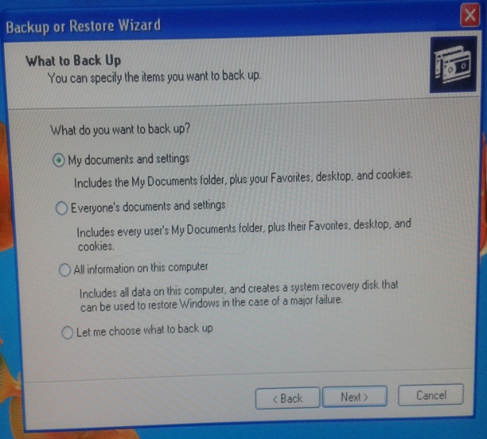
Backing up
After clicking the option “backup” a wizard will come up offering ways how you would want to back up your files, and so I selected “backup files and settings” then followed on to click “my documents and settings”. After doing so a box will appear asking where to save. As I didn’t have a USB I was directed to save on the network.

Slide 7
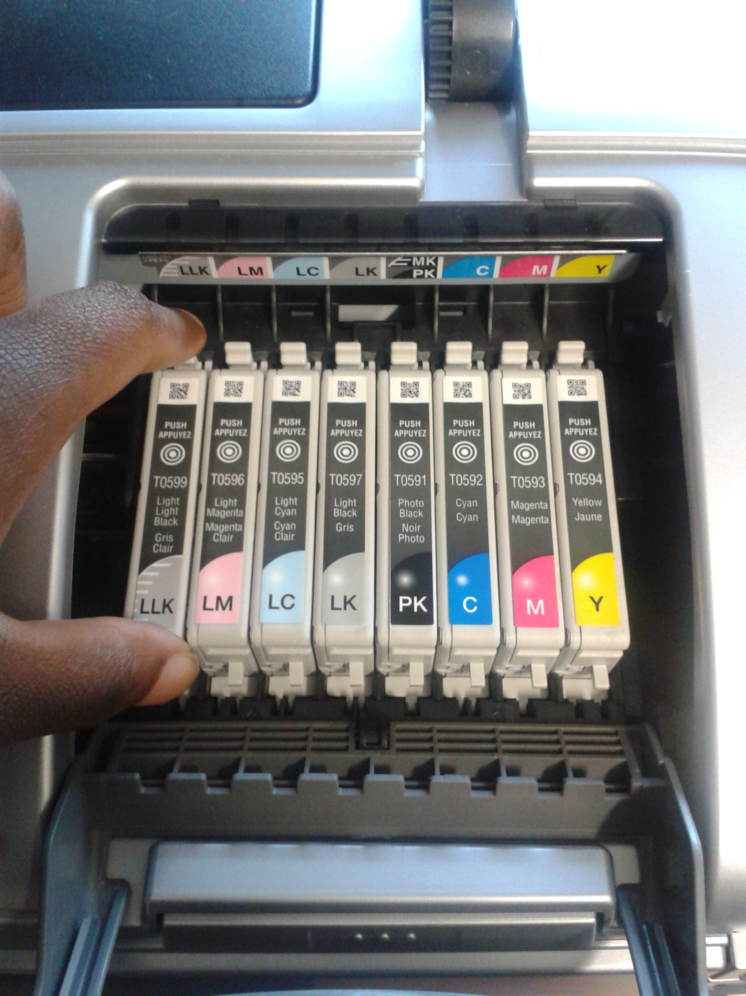
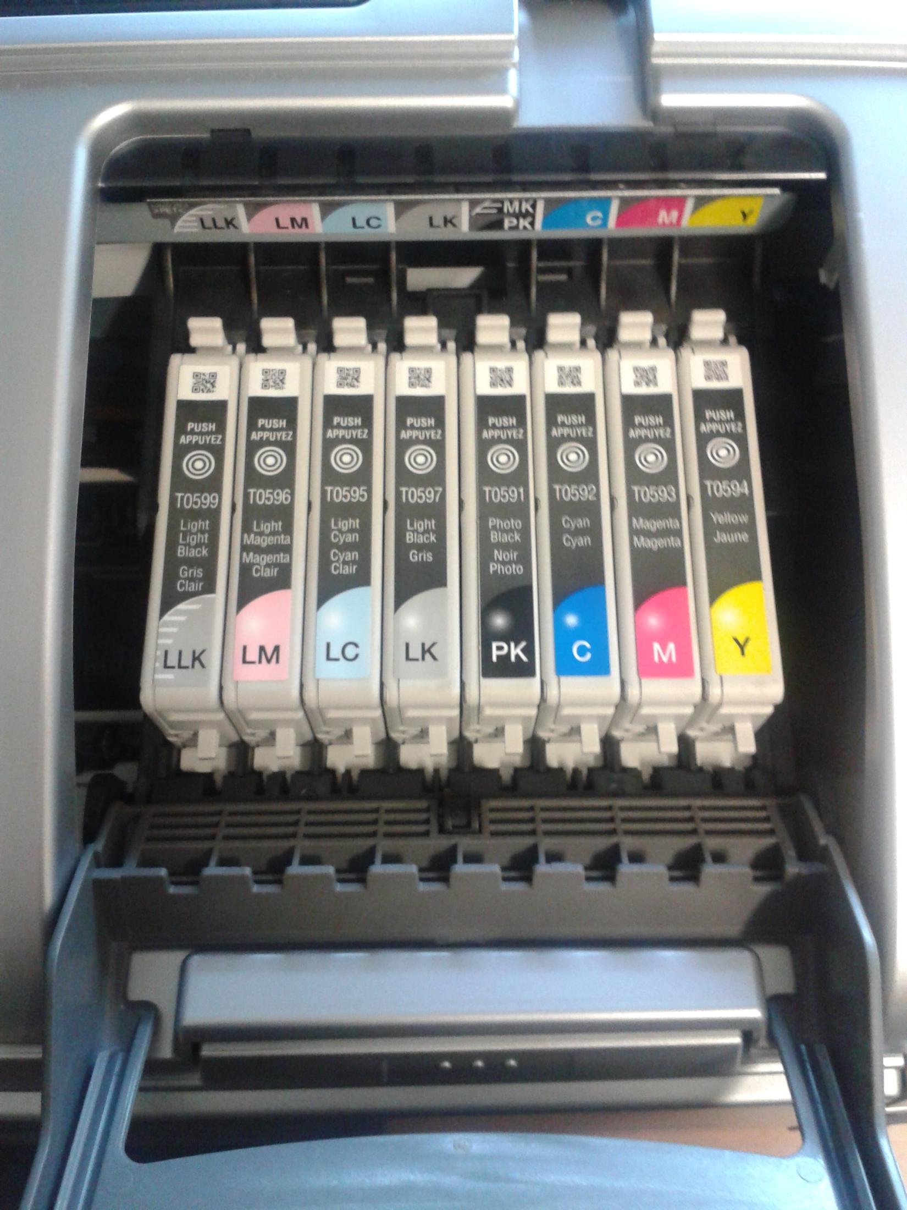
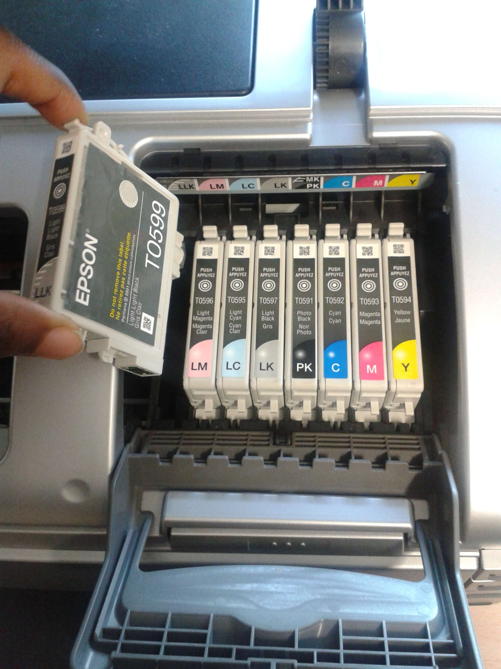
Replace printer cartridge
With this printer that is having its ink cartridge replaced, it has multi selections of colour cartridges rather than older style printers that have just single cartridges for colour ink. In the photos show the process of how to replace the ink cartidges in this printer.

Slide 8
Disk cleanup
From the start menu to accessories, then system tools there will be an option to select “disk clean up”. Once clicked a box will open, and all that is needed is to select “OK” and the clean up will begin.

Slide 9
Delete temporary files
When deleting the computers temporary files, in order to delete them you are to go to the computers “local disk” then onto “Windows” and continue on to find the folder “Temp”. When in that folder temporary files will be visible, and in order to delete them you are to highlight them then right-click the option “delete” and once clicked a box will appear asking you to confirm.

