Slide 1
Software utilities
Gladys Nzita-Mak

Slide 2
Disk defragmentation
Disk defragmentation makes computers run efficiently. When you save, change or delete files on your computer or install programs, the computer stores all the data in different parts of the computer. When the files on your computer are fragmented they are both disorganised and found in the wrong part of your system. This causes the your system to run slowly. Defragmenting your computer system brings together your files and organises them, improving your computers performance. Because defragmenting your computer is a benefit, an example would be that if a specific computer program wishes to be open, if will need to access other files on your system, but if these files are fragmented and are located in different places, it would be hard for your computer to retrieve those files and so it will take quite sometime for that program to be opened. So defragmenting your computer will improve the way your computer runs. By defragging, free spaces will be joined up so that a file will have all its data together, which makes retrieval fast and efficient.
Before disk defragmentation
After defragmentation

Slide 3
Anti-virus
An antivirus software is used to detect, prevent and remove viruses, worms and Trojans from computers and laptops. A virus is a program that is made to delete your systems data and corrupt files. Antivirus’ track viruses by identifying the virus signature. Making sure that your antivirus software is up to date is important because new viruses may come out regularly, and your antivirus is able to update and find new ways to destroy and remove them from your system. Updating your software will benefit you and your computer system. An example of an antivirus is Norton 360. It is installed onto the users computer to protect their system from viruses, and does daily updates backing up files and detecting if viruses occur. It s a useful program because it reminds the user that their system is protected. An antivirus software works by firstly detecting a virus (in this case malware), it then gives out a warning to the user offering a set of options of what the user wants the antivirus to do with the malware (remove or to ignore it), if the user has selected that the malware should be removed it then removes it from the computer including all the viruses, spyware and Trojans and prevents the malware from returning.

Slide 4
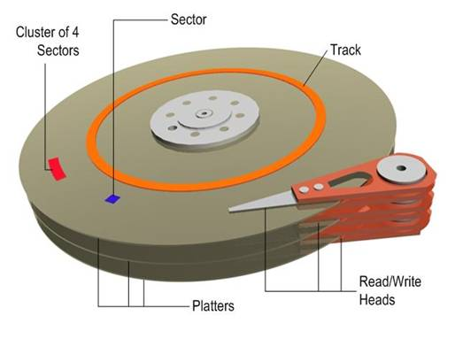
Disk formatting
Disk formatting comes in two stages,
Physical formatting – testing your disks surface and scanning it for any imperfections and setting aside sectors which can’t be accessed
Logical formatting – preparing your disk by setting up a file system that would define how files and folders on your disk will be stored and accessed
High-level formatting processes writes material allowing your operating system to work together with the disks boot sector, the root directory table and the FAT table. When you format your disk, it will leave blank space leaving your disk empty destroying all the content that was previously on the disk. Although the files that have been deleted are still on the disk, but do not show up because they are no longer part of your directory’s structure.
Also when connecting USB or media devices to your computer, it may require a disk format so your computer can be able to recognise it.
Diagram of disk

