Slide 1
Task 2 P3, P4, P5
Gladys Nzita-Mak

Slide 2
Digital Animation Formats - P3
P3
Format | Positives | Negatives
Animated GIF A GIF is a bitmap format | Supports all web browsers Popularly used on websites The size is smaller to make the picture quality better | Its maximum palette is 256 colours this means poor looking images
Dynamic HTML A set of codes which is used to create animations that can be used on websites | Used to create animations of websites Fast, loads up well | Doesn’t work in all web browsers Coding takes a long time / time consuming
Flash, Shockwave Flash is an adobe program which animations can be created and edited on, Shockwave is a program that allows flash to be ran | Can create useful animations like rollovers for websites Animations are done easily (frame by frame) Flash games can be made Content can work on mobile phones | Takes some time to learn how to use adobe flash Users are required to download flash shockwave for web browsers
QuickTime A multimedia player that supports animation, sound and video clips. | Supports animation, video, sound and images Works very well on Macintosh computers | Buffers to much Works best on Apple Mac computers
Real player Multimedia player that supports QuickTime along with windows media formats | Only useful for playing its own formats RM &RMV | Whilst in use, pop ups occur Takes some time to load up Only plays certain file formats

Slide 3
Tools in Flash – P4

Slide 4
Frames
In flash, frames are made when you want to show a change in your animation. Frames are used to show motion, in a single frame it can contain a new image or even a shape that has moved from a different place that it was in on the frame before.
For example, you can have a shape placed anywhere in your first frame. And in the next frame you can place it elsewhere. As you continue to create more frames you can continue to place this shape anywhere in your animation.
When played back, your animation will show your shape moving in different places

Slide 5
Layers
In adobe flash, layers are used to organise how you make your animation. You can have (for example) three layers, and on each layer they can contain text, a shape, and a button. You can choose to lock a layer and to hide a layer.

Slide 6
Controls
The controls in flash are the set of tools in the toolbox.
When using flash you can use these tools to help you to create your work.
For example in the picture you’ve got your set of tools and use can select tools like the text tool to add text to your work, or you can use the ‘mouse tool’ to move objects around.

Slide 7
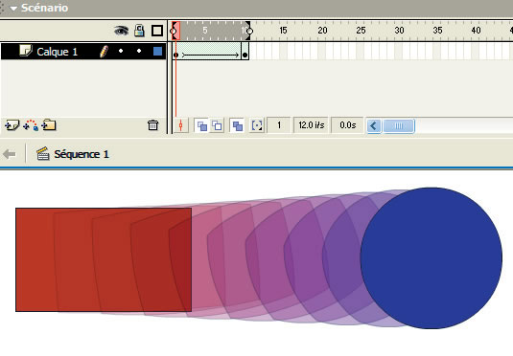
Tweening
When tweening, this is where halfway frames are produced in order to show a difference between two images. Tweening is done to show how your first image has evolved into the second. Tweening creates movement or morphing.

Slide 8
Buttons
Buttons in flash can be used to control an object in your animation. Buttons can be coded to control other shapes in an animation, whether you cant the button to make your shape go up down left or right, its all In the way you code it.
For example in the picture, the green arrows have been coded to control the purple shape to move it up down left or right.

Slide 9
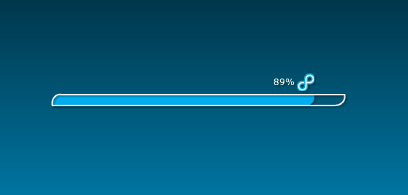
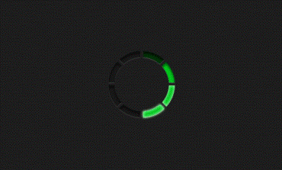
Preloaders
Preloaders are short animations that keep a user entertained whilst the program (or even game) is loading up information. Preloaders can either be seen as an animation, a display message or show a progress bar showing the percentage of how much has been loaded.

Slide 10
Scripts
Scripts are when you want to code your animation. They are written in a special type of way that the program can understand in order to make your animation run well.

Slide 11
Animated rollers
Animated rollovers are mainly used in websites. You can notice them when you hover your mouse over them. When hovered over they may change appearance.
For example, in the pictures below, the word ‘connect’ looks the same as the other buttons on the right, but when hovered over, the colour has changed into a white colour.

Slide 12
Email attachments
When sending an email you’re able to attach files to your emails. These files can be:
Photos
Video clips
Documents
Music files
Usually some emails have limits on how much attached items you can send.

Slide 13
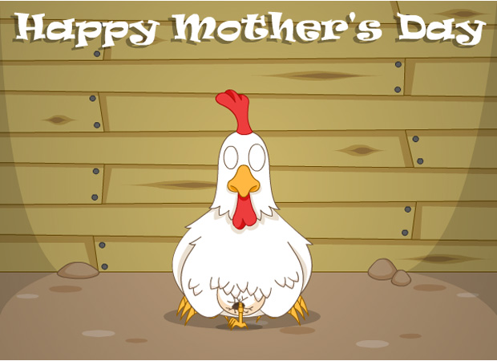
E-card
An E-card is an electronic card (greetings card) that can be found on the internet and can be sent to anyone who has an email. E-cards have become popular because they are amusing animations that are sent to friends or family as cards and can be customised.

Slide 14
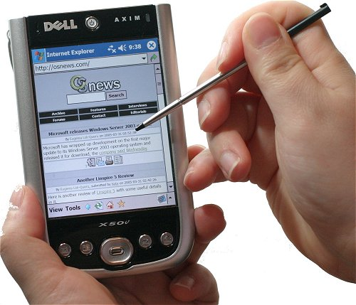
PDAs
A PDA (Personal Digital Assistant) is a device that includes internet access, and can be used for computing, emailing and as a personal organiser.
Considerations for a PDA should be that all video and animation formats should be able to play on PDAs, although not needed because multimedia doesn’t have to be used on PDAs even though some models today are made in full colour, others are still black and white.

Slide 15
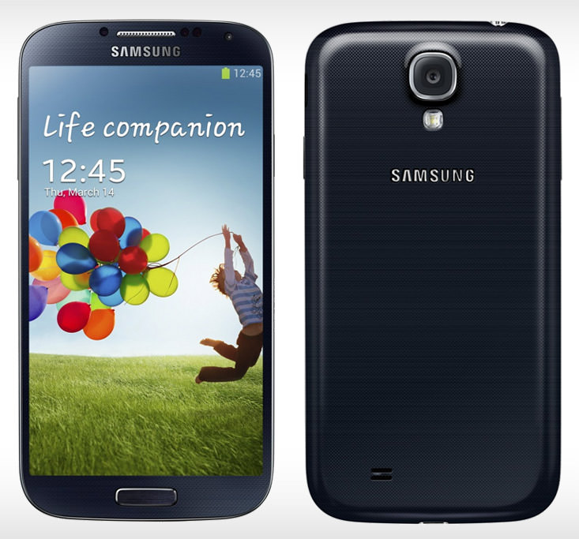
Mobile phones
A mobile phone is used to make and receive calls (to either house or other mobile phones) all over the world. Mobile phones made recently aren't all made for using flash. This means not all video formats can be played and so it should be considered that making applications like flash player should be allowed so certain video formats/animations can be previewed.

Slide 16
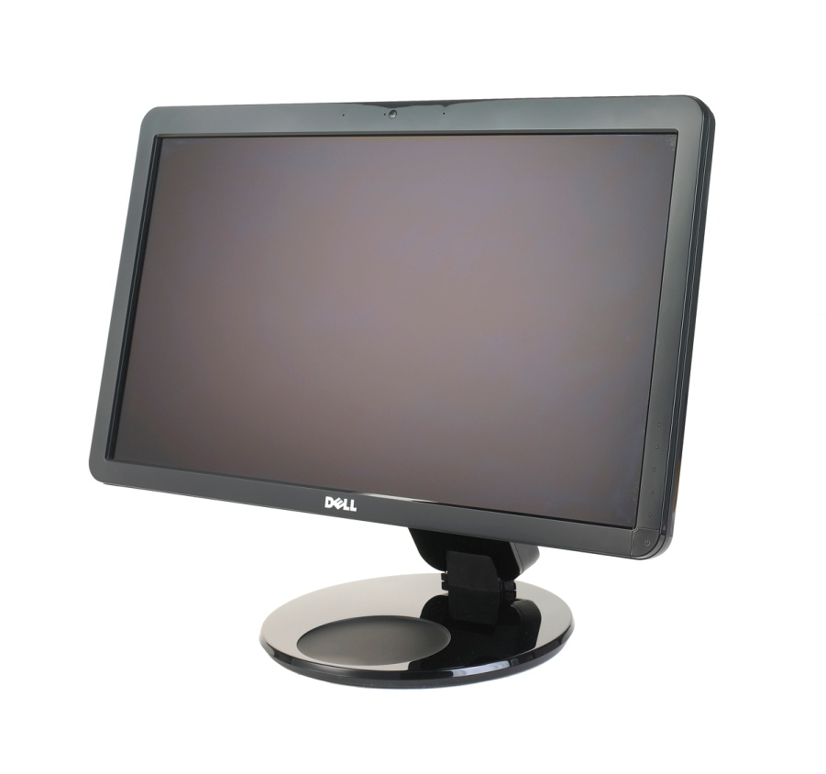
Monitors
Monitors receives input from the computer and outputs it onto the screen. On a monitor it is easy to view animations and videos. For an animator, they will set the correct type of resolutions they need to produce their work.

