Slide 1
Computer hardware devices and components
By Gladys Nzita-Mak

Slide 2
devices and components
Input
Keyboard
Mouse
Microphone
Tablet
Output
Monitor
Printer
Speakers
Processing
Central processing unit (CPU)
Storage
RAM
Hard disk drive
Memory stick
Floppy disk
CD+RW

Slide 3
Keyboard
A keyboard is used for being able to communicate with the computer. It is used to input information into your computer. Keyboards are used to type in data/information into your system and to type up documents. There are also different types of keyboards: qwerty (the most common used for keyboards laptops and Smartphone's), concept (mostly used in fast food restaurants and have pictures on them for users who do not understand how to use qwerty keyboards well enough) and software keyboards (virtual/on-screen keyboard that users can use instead of using the normal keyboard, this is used to an advantage with tablets and touch screen computers/laptops).

Slide 4
Mouse
A mouse is used to interact with your computer, the user is able to move the mouse, click and select objects and scroll up and down a page. Because a mouse is an input object, everything done on the mouse is seen on the LCD monitor connected to the computer (the monitor is the output). There are two types of mice which are: optical (uses a light or laser which tracks movement in order to work) and mechanical (contains a metal or rubber ball. When movement occurs the sensors inside detect the motion and moves the on-screen mouse in the same way).

Slide 5
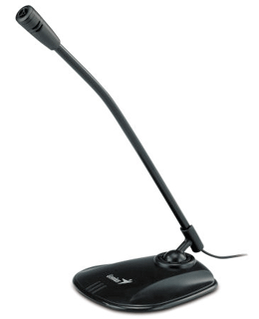
Microphone
A microphone is an input device that allows the user to be able to record voice notes onto the computer. When it comes to users buying a microphone they would consider it to be uses for online chatting as well as computer gaming or just natural recordings (e.g. Singing, recording instruments).

Slide 6
Central Processing Unit (CPU)
The CPU is the most important part of a computer. It processes all input data and gives out output onto the computer screen. It processes data so computer users are able to use tasks properly.

Slide 7
Random access memory (RAM)
Random-access memory (RAM) is a type of computer storage that allows users to access it randomly. It stores data that are in use.
Whenever a program is loaded, it goes through the hard drove into the RAM. The more RAM your computer has, the better. This means that because there is more RAM, data can be easily loaded from the hard drive into the RAM, speeding up your computer.

Slide 8
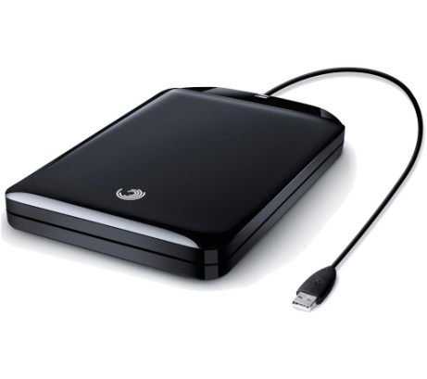
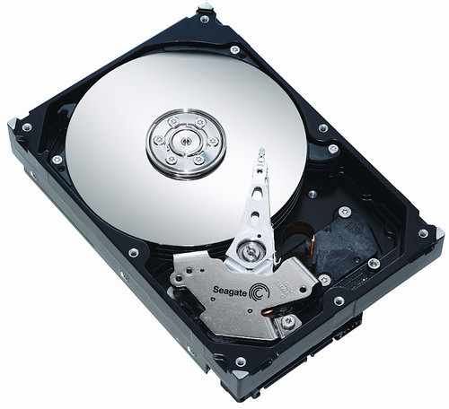
Hard disk
A hard drive is where the computer stores all its main storage. It is the largest storage component of a computer. It can hold over 100GB. There are two types of hard drives: internal and external.
Internal – The main storage device that stores all data on the computer. The operating system can also be found here as well as other programs.
External – Used to backup data (documents and programs). External drives are connected to computers usually by a USB cable.

Slide 9
Monitor &Screen display
A monitor receives input from the computer and delivers output onto the screen. By using a mouse to select a programme and opening it up, that input data is processed and given out as output as it opens up on the monitor, showing us what programme that has been opened up.
There are different types of monitors that have been used with computers over the years, and are still used now :CRT (cathode ray tube), LCD (liquid crystal display), plasma, touchscreen, OLED (organic light emitting display).

Slide 10
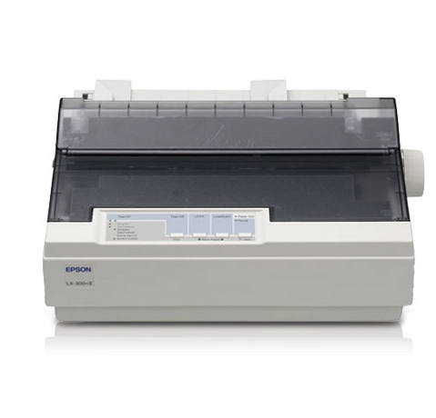
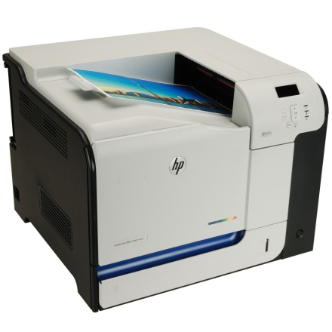
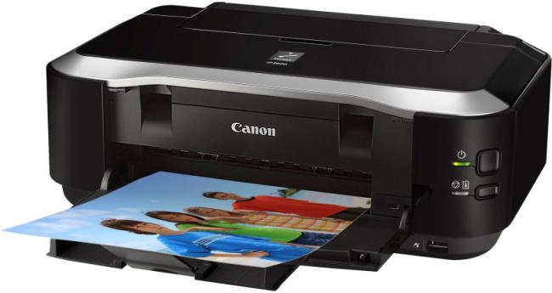
Printers
Printers receive input from the computer and delivers output by printing the given information onto a sheet of paper. The different types of printers are LaserJet, inkjet and impact. LaserJet printers are often used in offices as they are larger, print faster and are far more expensive, whereas inkjet printers are mostly used for home use, they are easy to use and are cheaper. Impact printers aren’t printers that are mostly seen in homes as they print with a print head making a mark on the paper creating an impact, and seem to wear out easily.

Slide 11
Speakers
When a sound file is clicked, it gets processed and is outputted into an audio and that would be heard by the listener when speakers are turned on. Outputs like a monitor, printer and speakers are all used to communicate with the user.

Slide 12
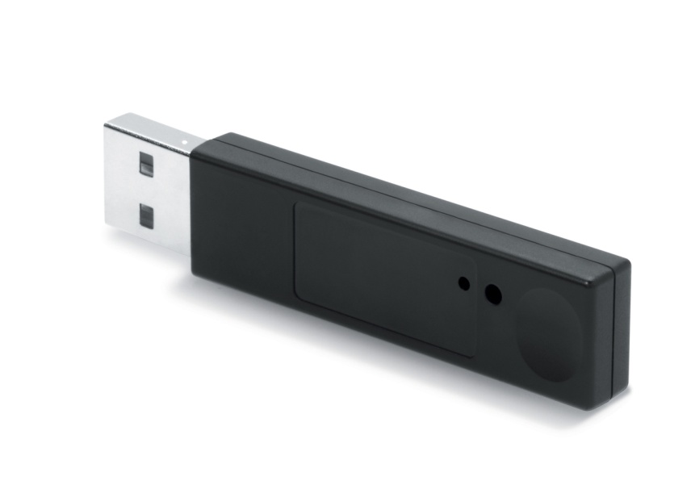
Memory stick
A memory stick can be used to store data/to save information and programmes that will be accessed for later use.

Slide 13
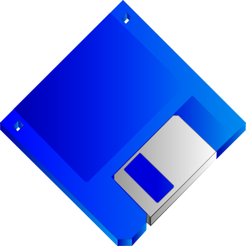
Floppy disk
A floppy disk is used to store a certain amount of memory onto the disk. It is mostly used for saving documents and for transferring data.

Slide 14
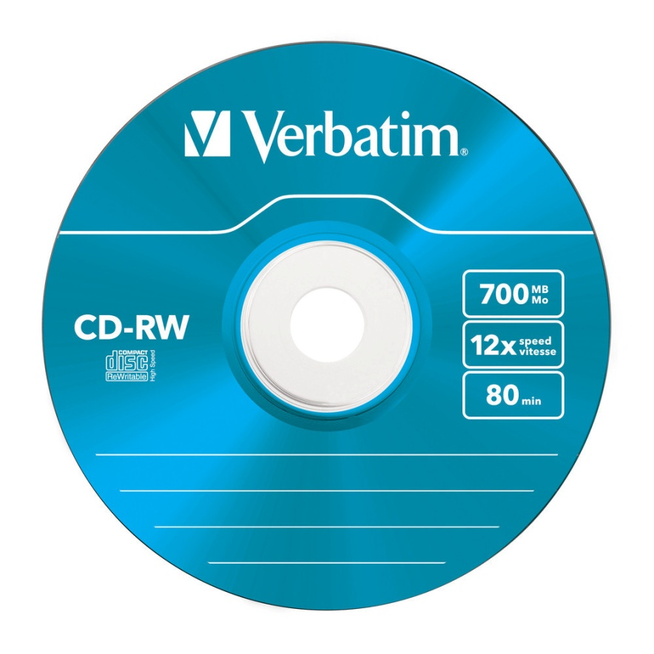
CD + RW
CD RW is an empty CD which can be used as a way to store files or music using a CD burner. CD’s are read by lasers in the CD-ROM drive.

Slide 15
How a mouse works
When a mouse is plugged into a computer it allows you to take control of the computer by moving it around and clicking items that you want to open and access. It also allows you to save information. What ever you do on a mouse it is shown on the monitor connected. When using a mouse it signals and reads your moment with the computer so it is easier for you to interact with the computer.

Slide 16
Software packages
System software
Windows 7
Linux
Unix
Mac
Application software
Microsoft word
Google Chrome
VLC Media Player
The Sims
Symantec

Slide 17
System software
System software's like Windows 7, Linux, Unix, Mac are operating software's that controls the computer’s hardware, runs tasks, manages applications and controls devices. Operating Software's allow users to interact with the computer.

Slide 18
Application software
Application software run under operating software and are software programmes that perform tasks on your computer, such as Microsoft word. It allows a user to create and save documents.

Slide 19
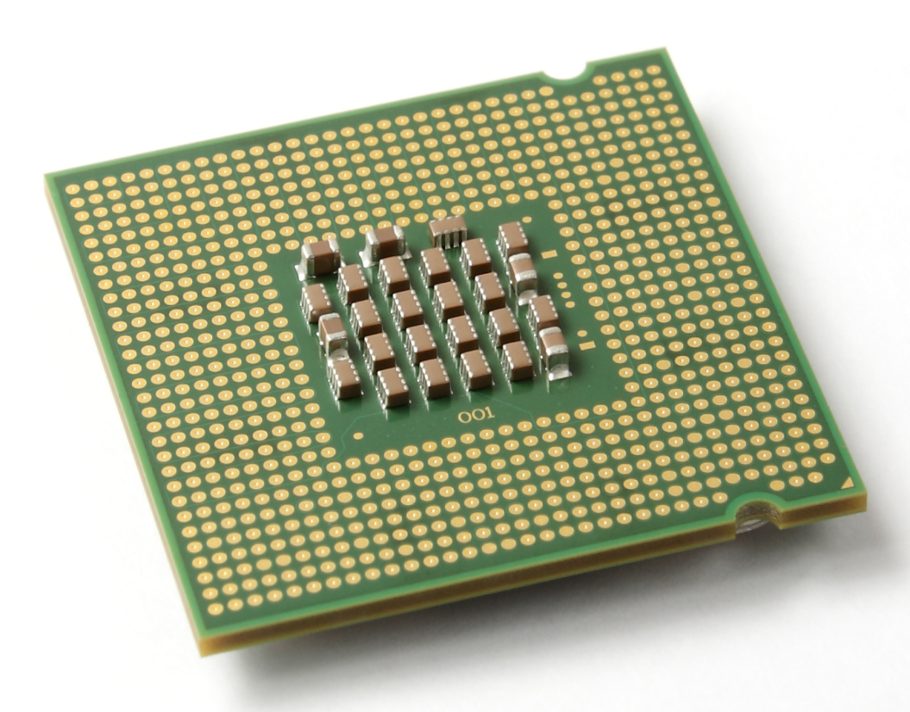
Processors
Processors; the CPU (Central Processing Unit) is known as the brain of the computer. A processors job is to process data. Whatever instruction you give, the CPU processes it and gives you an output. The CPU is an internal component of the computer.

Slide 20
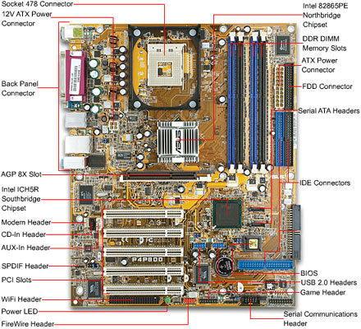
Motherboards
A motherboard is the most important component of the computer. It ties everything together, it has many connectors, sockets and slots where all important components are inserted in. The motherboard holds the CPU, BIOS, memory, both RAM & ROM, expansion slots, sockets, chipsets and more.

Slide 21
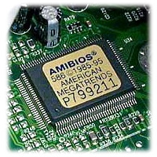
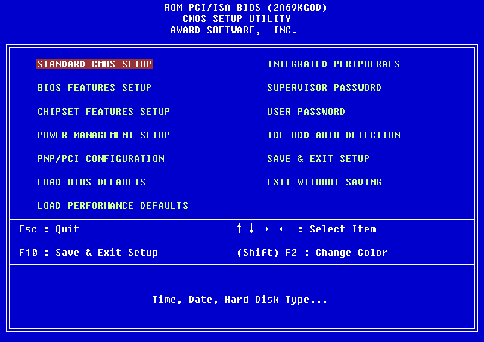
BIOS
The BIOS (Basic Input/output System) make sure that CPU, hard drives, ports and all other chips function together.
The BIOS is a chip found on the motherboard that works together with the POST (Power-on Self Test) and has instructions for your system to help it successfully boot up. The BIOS also works to give information to other components of the computer, like the hard dive and memory so they’re ale to load up the operating system.

Slide 22
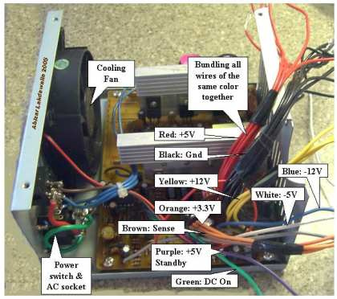
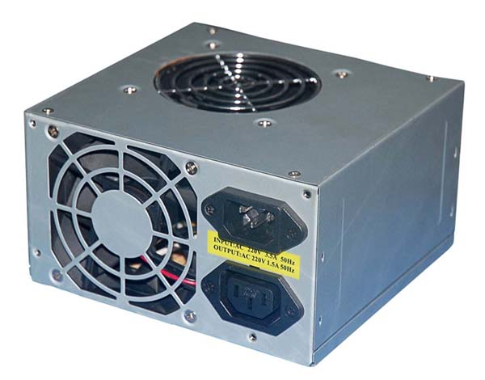
Power Supply
A Power supply unit supplies power to all components of the computer.
It converts a required amount of AC current to DC (from between 115V – 230V) current required for internal components of a computer.

Slide 23
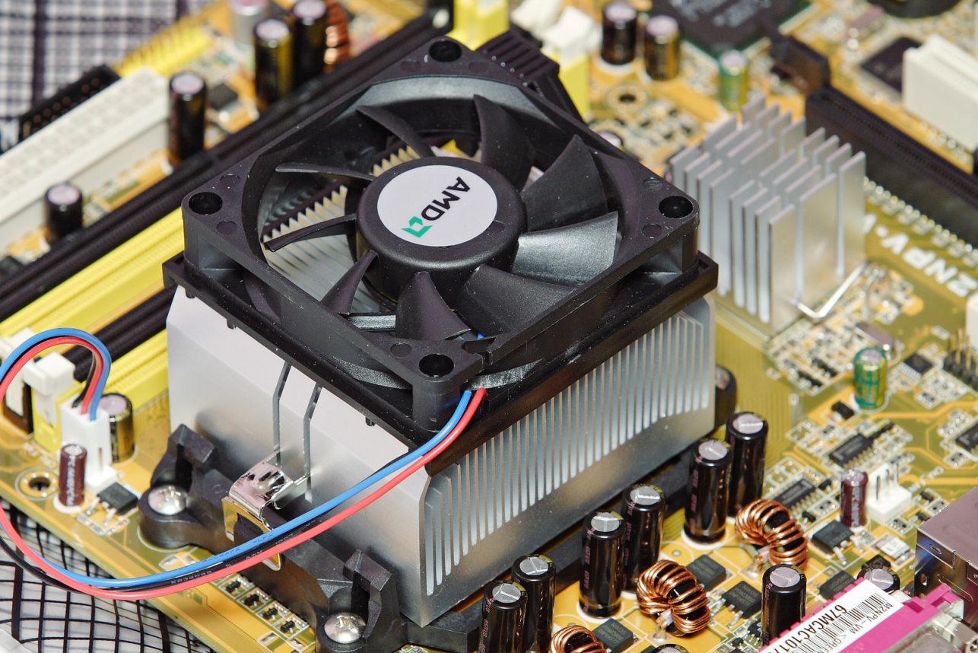
Fan and heat sink or cooling
A heat sink is a component that draws in heat from the processor (for instance the CPU) and cools it down. It basically absorbs unwanted heat and moves it away from high temperature objects.
The Fan cools down parts inside the computer and stops it from overheating.

Slide 24
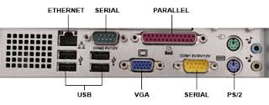
Ports
A port is where you are able to insert different devices. Ports are used to insert internal and external devices like Keyboard, mice, monitors, modems and printers into your PC.

Slide 25
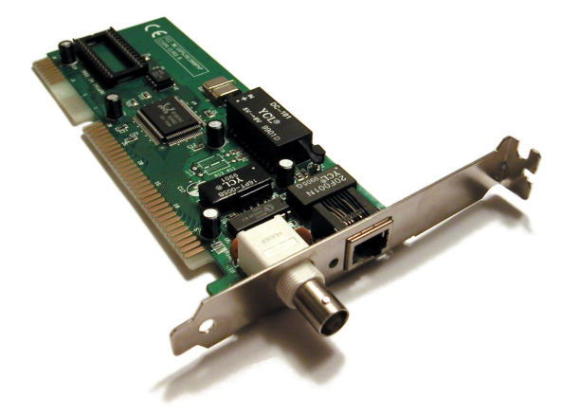
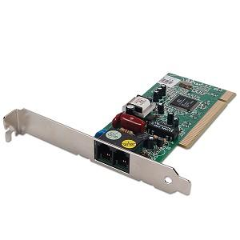
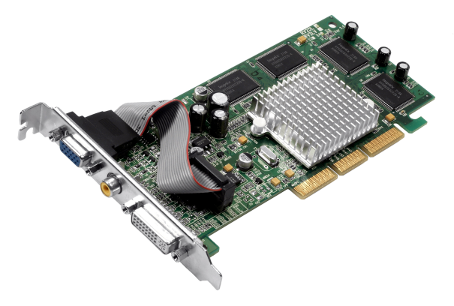
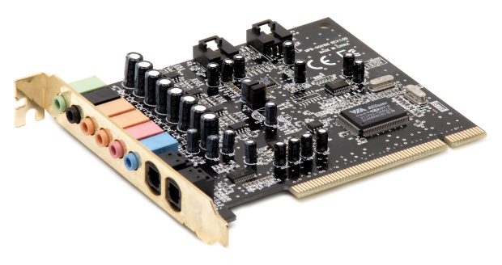
Specialised cards
On the motherboard there are extra card slots for cards to be inserted in. Those cards can be:
Graphics cards – Has its own processor and memory specially for storing graphic files.
Network cards – Inserted so your computer is able to connect to a network (WIFI)
Sound cards – Allows the computer to output sounds onto speakers, allows you to be able to record sound files and lets you store them
Modems – Allows a computer to send and receive data through telephone lines
And plenty more.

Slide 26
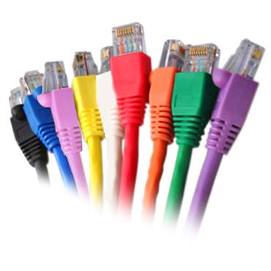
Cabling
DVI
VGA
ETHERNET
USB

Slide 27
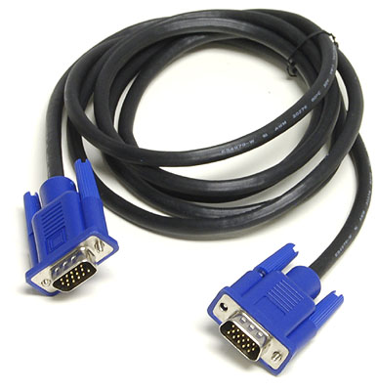
VGA
A VGA cable (Video Graphics Array) has 15 pins and is used to connect your computer system to a monitor in order to transmit video signals. VGA cables use analog signals instead of using digital signals. It was first developed for IBM computers, although nowadays all computers use VGA, but a more advanced version.

Slide 28
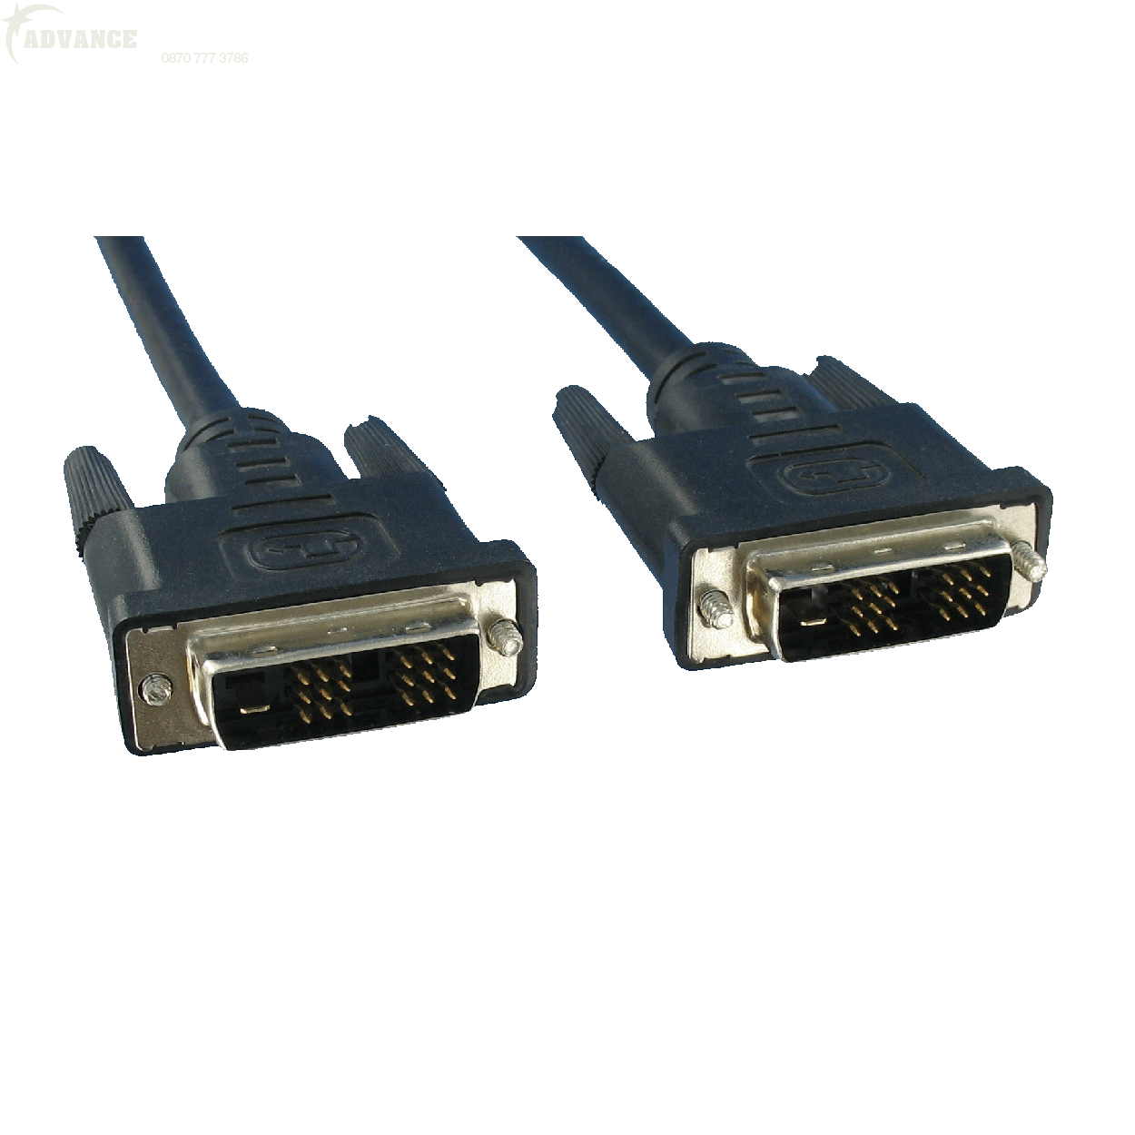
DVI
DVI (Digital Visual Interface) cables converts digital signals taken from a graphics card into analog signals and sends it to the connected monitor. DVI cables connected to a graphics or video card are used to an advantage as they give out a more sharper image.
There are different types of DVI cables that also converts analog signals into digital such as:
DVI-A
DVI-D
DVI-I
DVI-DL

Slide 29
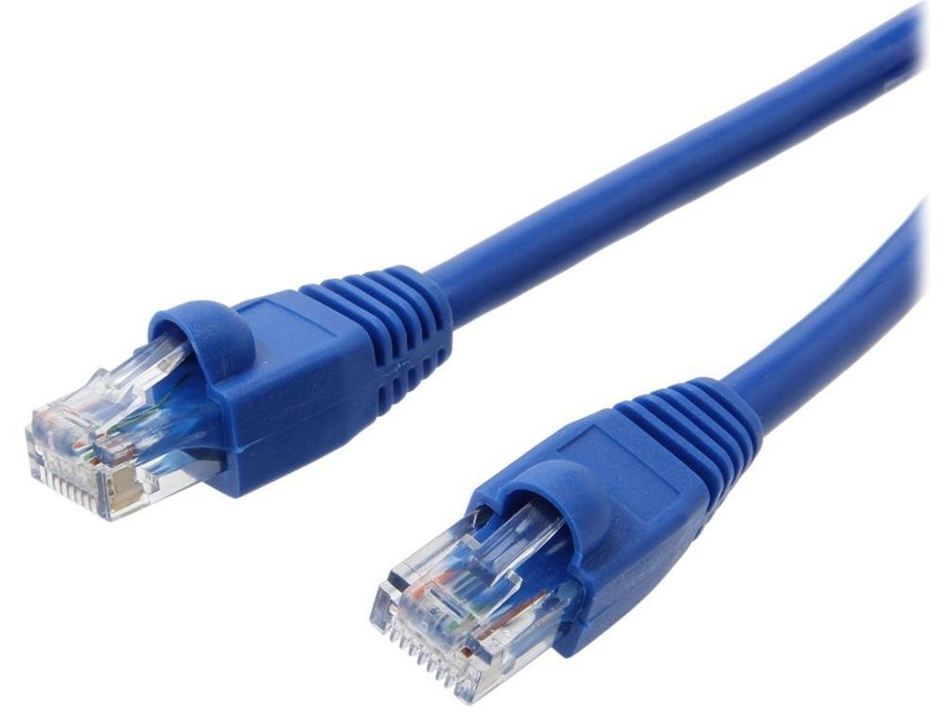
Ethernet cable
Ethernet cables are used to connect a computer to the internet. They have an 8-pin RJ45 connector on each of its ends and they can be used for other devices like games consoles. They are connected into modems which allows access to the internet.

Slide 30
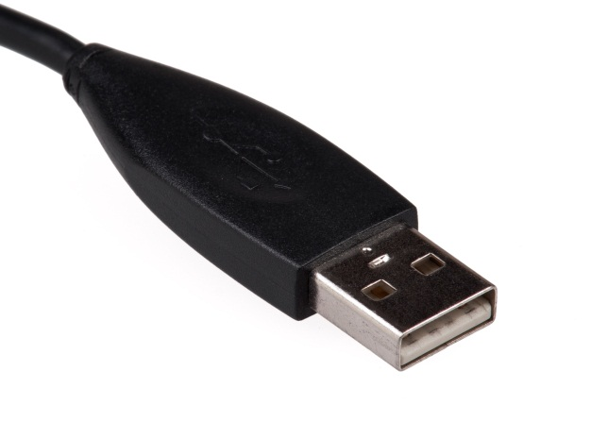
USB
USB (Universal Serial Bus) cables are used to connect peripheral devices into a computer/laptop. It can connect devices like Mice, keyboard, printers and even cameras.
USB’s can also be used as a storage device that can store documents and other files.

Slide 31
Backing storage
Hard disk – Used to save large amounts of memory (documents & programmes), it can be portable or internal, one of the main components of a computer
Floppy disks – Save certain amounts of documents on, portable and very handy
CD-ROM – Read only files, can store certain amounts of data
Magnetic tape – an external storage device, can be used for copying data, audio and video. Used in a tape drive.

