Slide 1
Explaining the principles of web animation
Gladys Nzita-Mak

Slide 2
Animated Interface Elements
DHTML
XHTML
JAVA

Slide 3
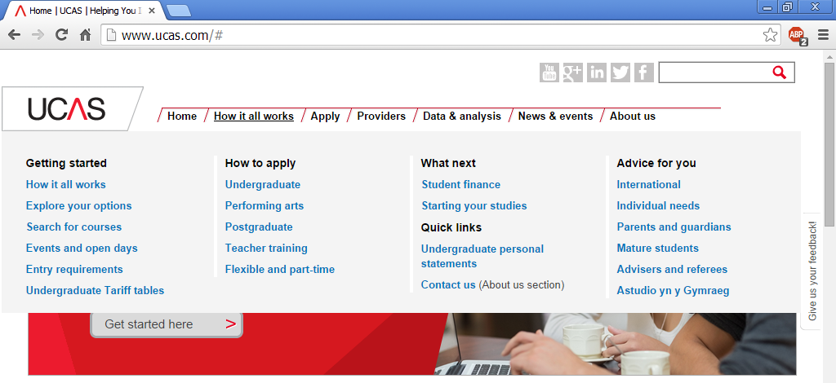
DHTML
DHTML is a programming language which can be used in animation win different ways such as:
Animating texts and images
Embedding
Rollovers
Dynamic menus
DHTMLs allow web pages to have animations. Benefits of using DHTMLs are that web pages do not have to load up fully in order to function, doesn’t require any plugins, a disadvantage would be that it may not be compatible with every web browser (which means the user will have to upgrade their browsers to recent versions to use sites with DHTMLs) and that it takes a while to code with DHTML as it is difficult for some.
In the image on the right, Whilst on the UCAS website, if a user is to rollover on the top section, a drop down list appears, this has been done with using DHTMLs.

Slide 4
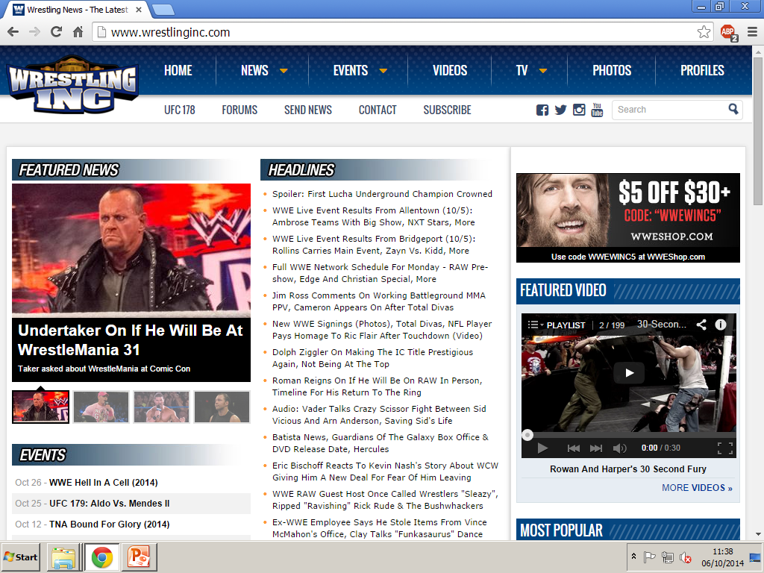
XHTML
XHTML is a programming language in the XML family that can be used in a way that (for example) if a website were to have a video attached onto their website, by using XHTML is can grab the video and place it onto the website, and once clicked to be viewed, instead of having the page be directed to the source of the video, it will remain on the page. For example in the image on the right (with the section highlighted), by using XHTMLs allows a website to have videos on them and to also be viewed on that website. Benefits of XHTML are that it supports a lot of applications and is compatible with a good amount of formats such as PDF and RSS.

Slide 5
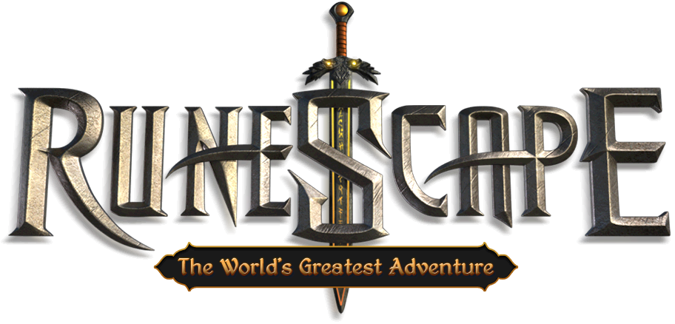
JAVA
Developed by Sun Microsystems, JAVA is a programming language used to create applications, and allows certain types of media to be played on compatible devices such as mobile phones and PCs. Benefits of Java is that once downloaded, applications, games and other java outlets can be ran anywhere which is very efficient. Also java provides good performance applications. The java language can be easy to learn and write, debug, compile and used for creating java applications, and is also secure. Drawbacks would be that it takes up some memory and can be slow at times.
RuneScape is an online game developed and written in Java, now alongside with HTML5

Slide 6
Digital animation
Gif
Bitmap
Vector animation
Compression
Scalability

Slide 7
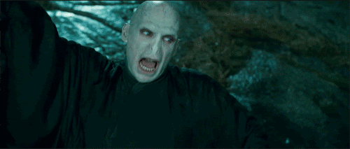
Gif
Graphics interchange format are compressed (so that the quality of the gif looks well) and limited to using 256 colours. Gif images are able to use different frames of imaged in order to create the illusion of movement. In the image below shows the character Voldemort from Harry Potter being animated as he is casting a spell. As you can see there are more of the same colours used in the image, possibly not more than 200 colours, these type of gifs are very popular on web pages and doesn’t contain large amounts of KBs.

Slide 8
Bitmap
Bit

Slide 9
Vector animation
Vector graphics are made by using lines, shapes and curves along with mathematical calculations to create images.
Advantages of vector animation are:
High quality animations – Vector images tend to be higher quality
Take up less space – although high quality, vector images don’t take up high amount of space unlike bitmaps
Adobe Flash supports vector animation as you are able to use it to draw and create your own animations, for example if a user were to draw a character using Flash they are able to animate it using shape and motion tweens along with other tools, being able to produce high quality animations.

Slide 10
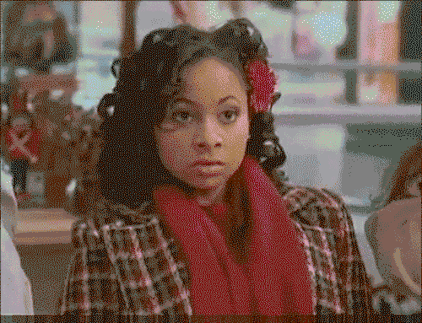
Compression
When it comes to animation, compression applies in many ways. For example with gif files, they are to be compressed in order for the quality of the animation to look good. Also whilst viewing video files in QuickTime, video files are to be compressed so that the video quality can look good during playback. If gif files are compressed lossless, then the gif will turn out with a looking like a high quality animation, whereas if compressed lossy, then it would have lost some data resulting in the animation being bad quality.
The gif file on the right is animated (the girl in the animation puts on sunglasses). This gif file has been compressed lossy, when played back it is quite blurry and slow.

Slide 11
Scalability

Slide 12
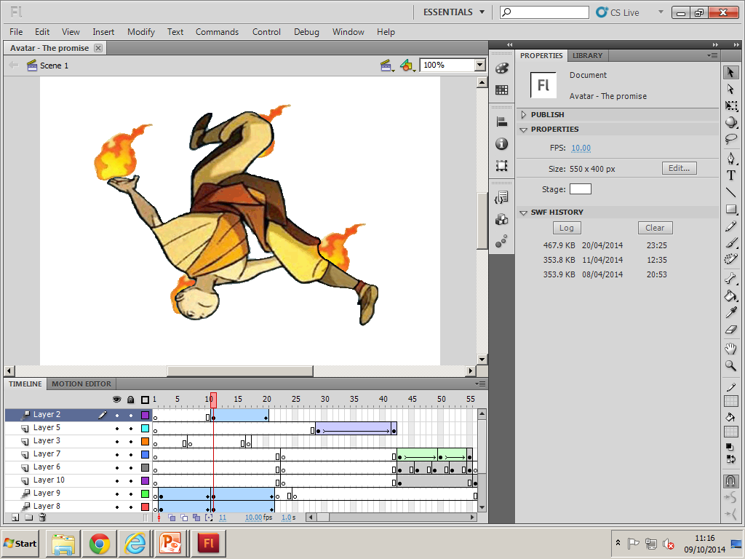
Web animation software
Adobe Flash
Adobe Flash is used to create animations using either multiple frames including having the animations animated by using tweening and motion, or can be animated by using the ActionScript programming language. It is an authoring program used to create 2D animations that can be compatible on both web pages and even mobile phones. With Adobe Flash you are able to produce well made Vector animations, being able to animate them and even able to code it. Flash provides users with a good set of tools including layers, controls, tweening, buttons, scripts etc. With these tools animators can produce all types of animations, for example using bitmap images, I have managed to create an animation with the tools provided.
Using Adobe Flash Professional I have used layers and tweening to animate the character above in the image.

